Slide 2
Welcome... to an introduction on WATAMS. The Wide Area Trap and Animal Monitoring System
for the effective control of grey squirrels, developed by Newcastle University.

Slide 3
The main costs of animal trapping relate to manpower, driven by the need for daily inspection of live capture traps and the difficulty to reduce pest populations at low densities.

Slide 4
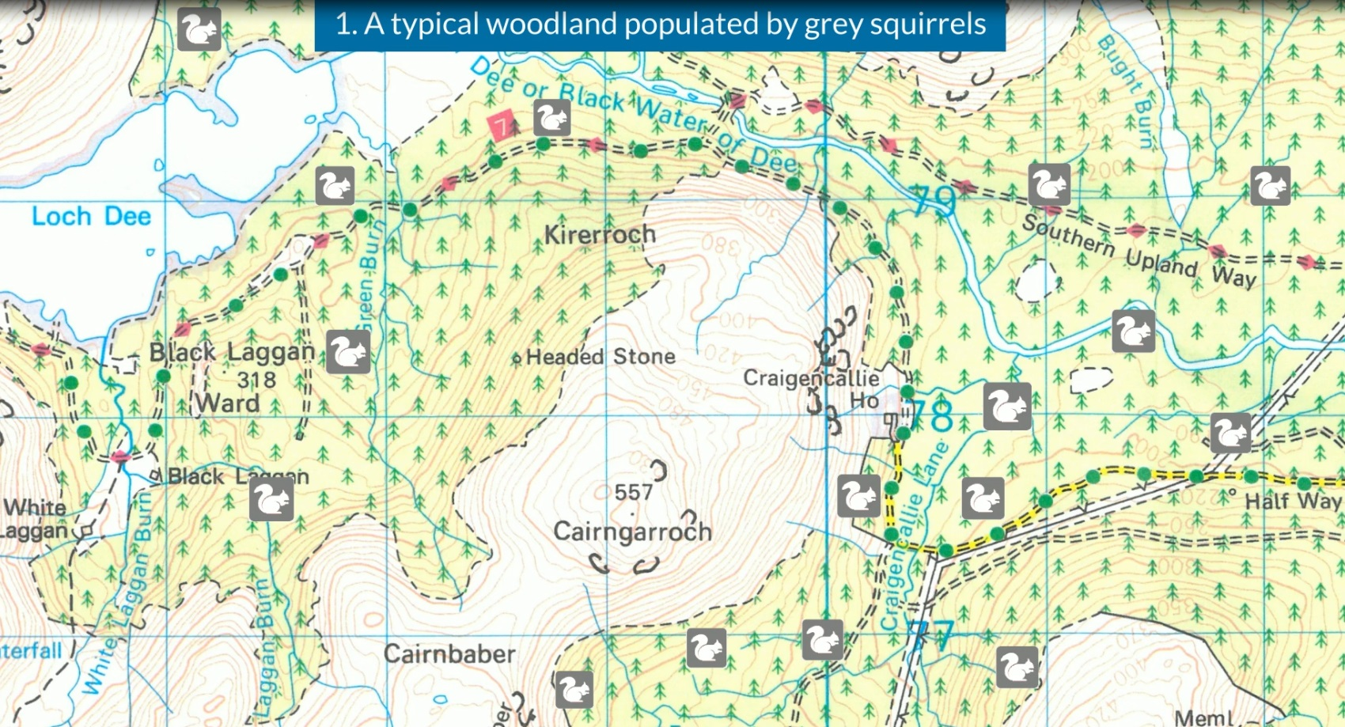
Imagine a typical woodland inhabited by both red and grey squirrels. This would require daily manpower to check all traps for any captured animals.

Slide 5
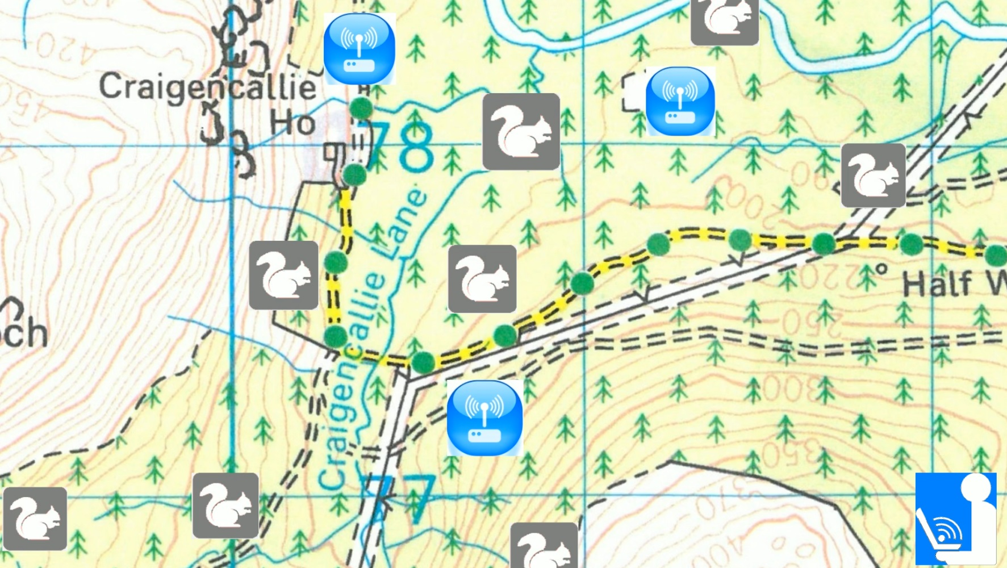
With the addition of WATAMS wireless sensor node technology within the woodland, we can monitor and supervise animal capture traps, providing significant benefits to landowners.

Slide 6
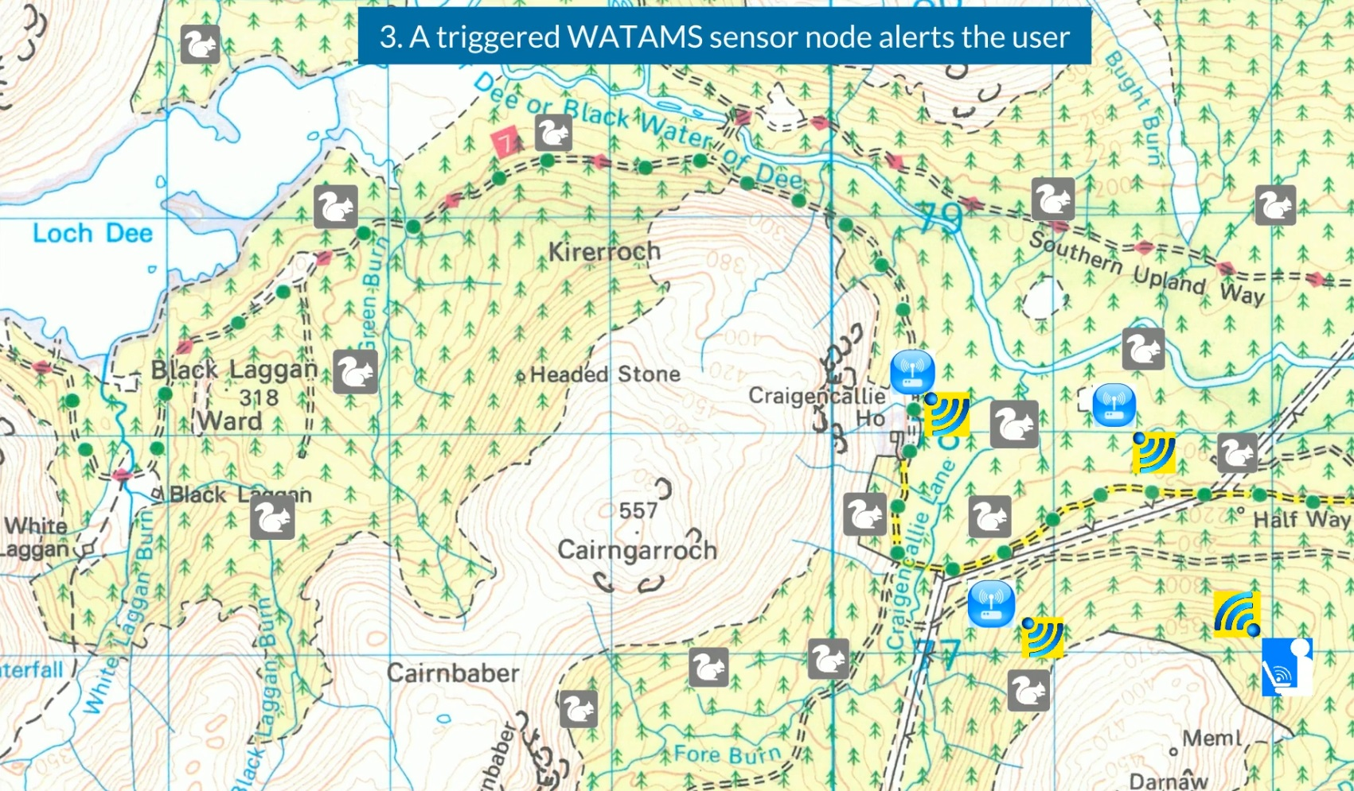
Once a trap is activated by an animal the user is immediately alerted and can respond straightaway. The information can be transmitted to a user using different techniques.

Slide 7
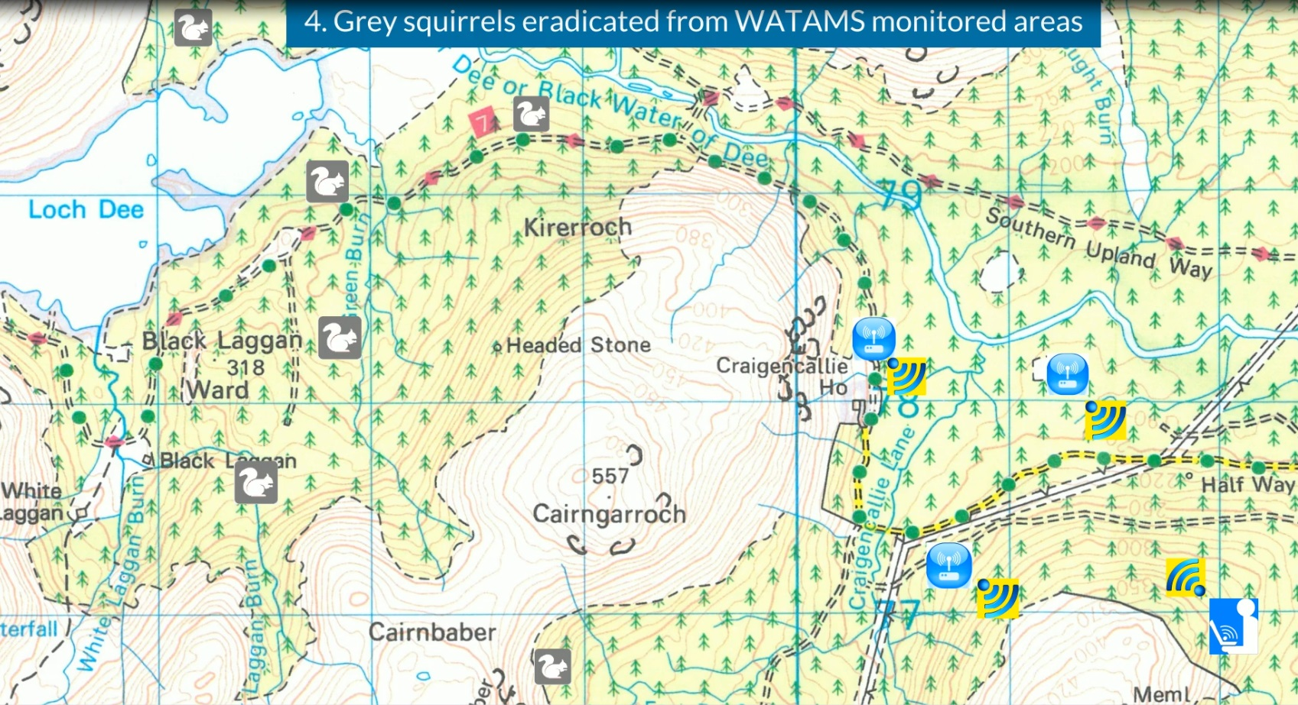
Once the grey squirrels have been eradicated from the area only a small number of WATAMS nodes need to be retained. The rest are spread out further to expand the squirrel free zone.

Slide 8
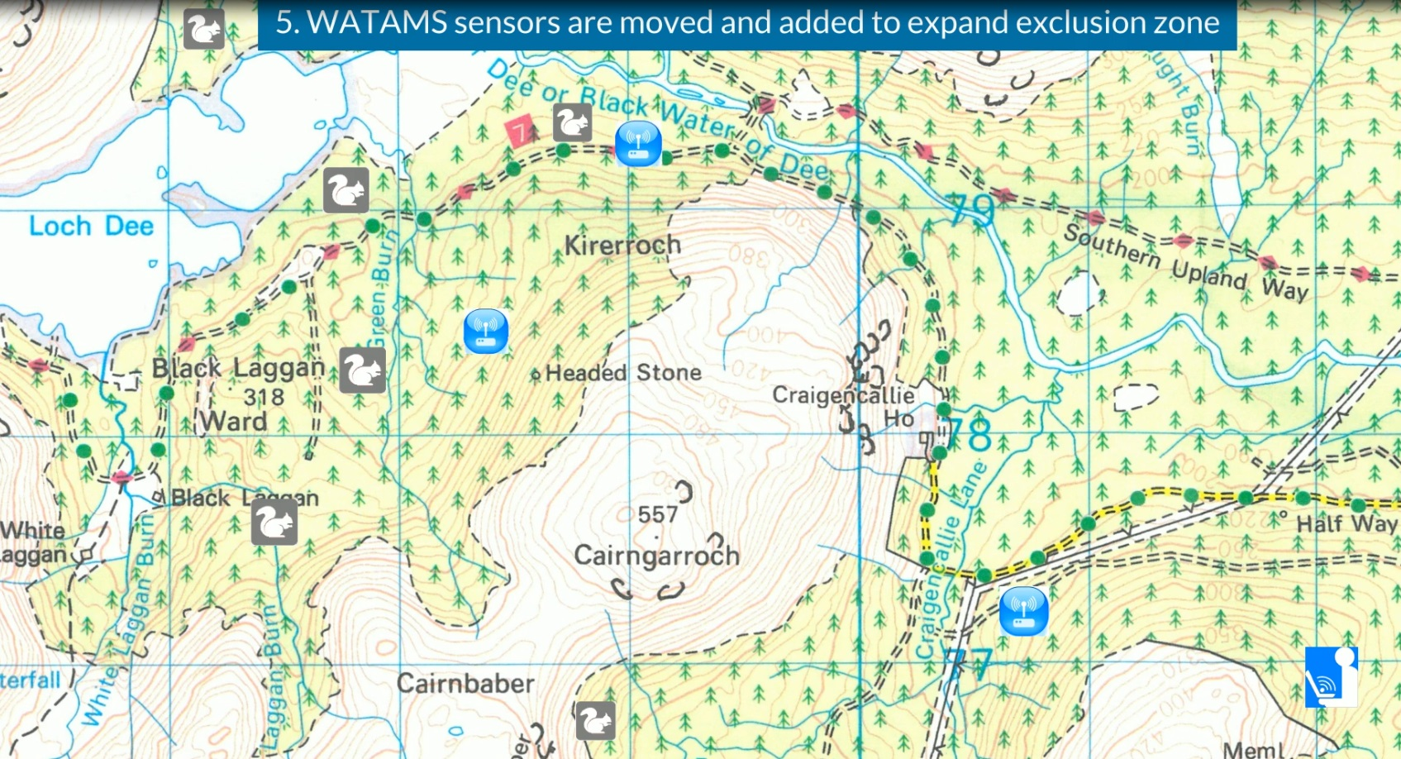
WATAMS sensors moved and added to expand exclusion zone.

Slide 9
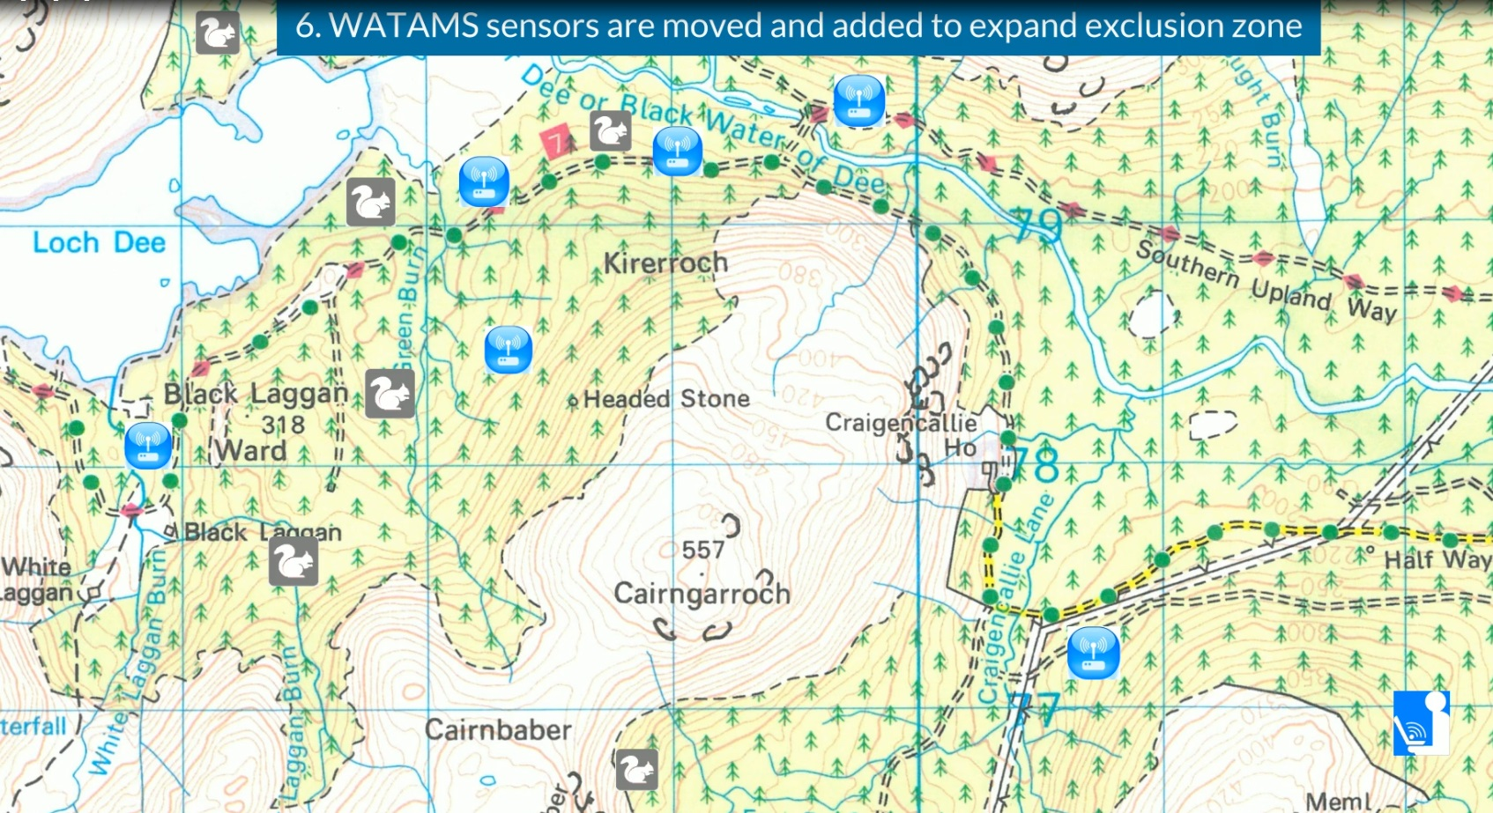
Only a small number of WATAMS sensors are required to cover the cleared area with additional sensors added to new woodland clearance areas.

Slide 10
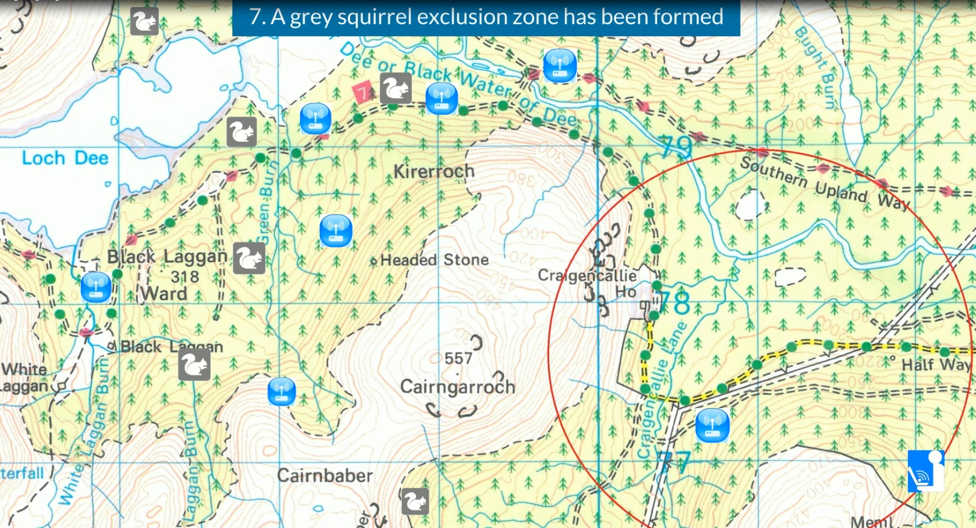
We now have a grey squirrel exclusion zone. This only needs to retain a small number of WATAMS sensors to ensure that if any greys do return a user is alerted immediately.

Slide 11
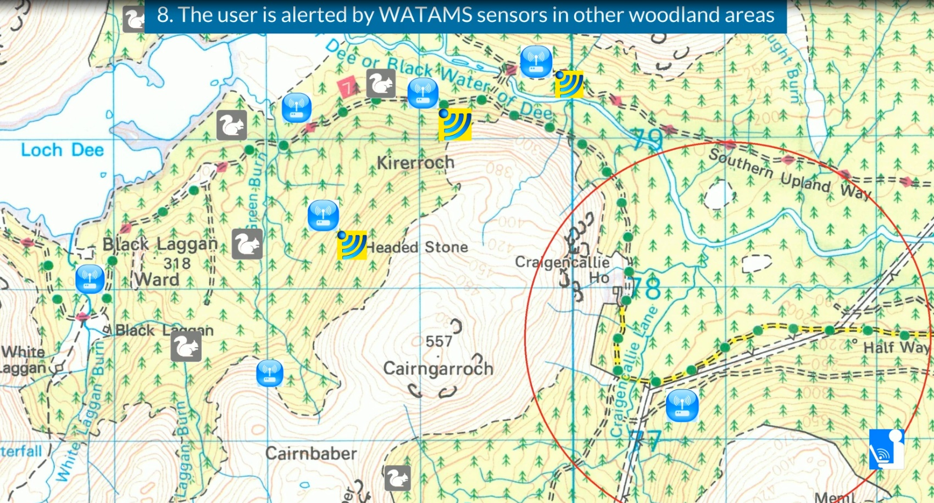
The other WATAMS sensors placed in other woodland areas alert a user when a trap is triggered.

Slide 12
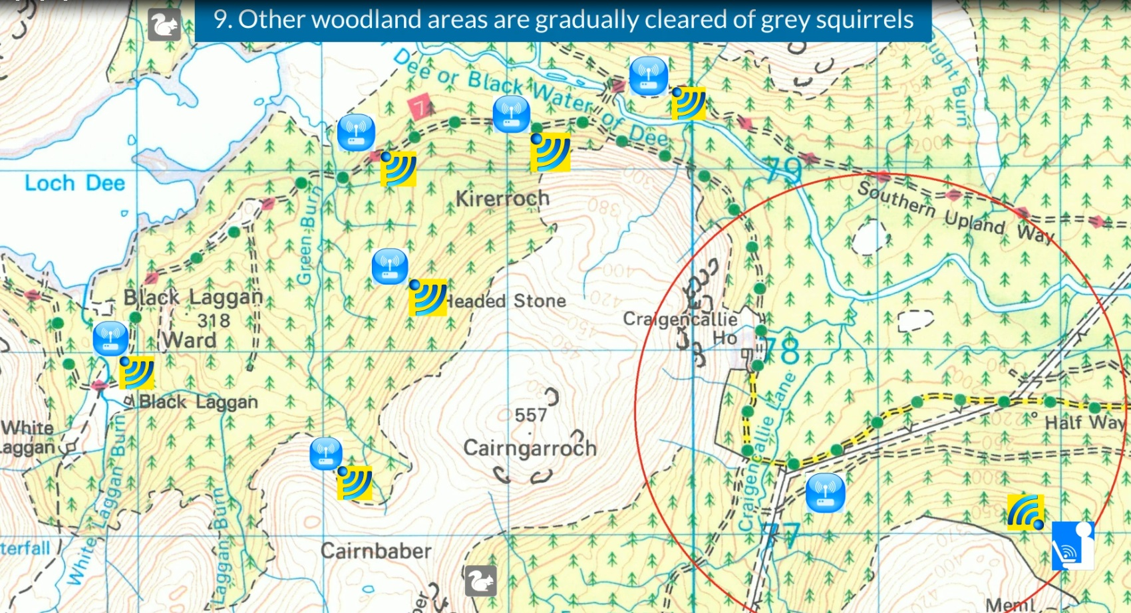
Once the grey squirrels have been eradicated from the area only a small number of WATAMS sensors need be retained.

Slide 13
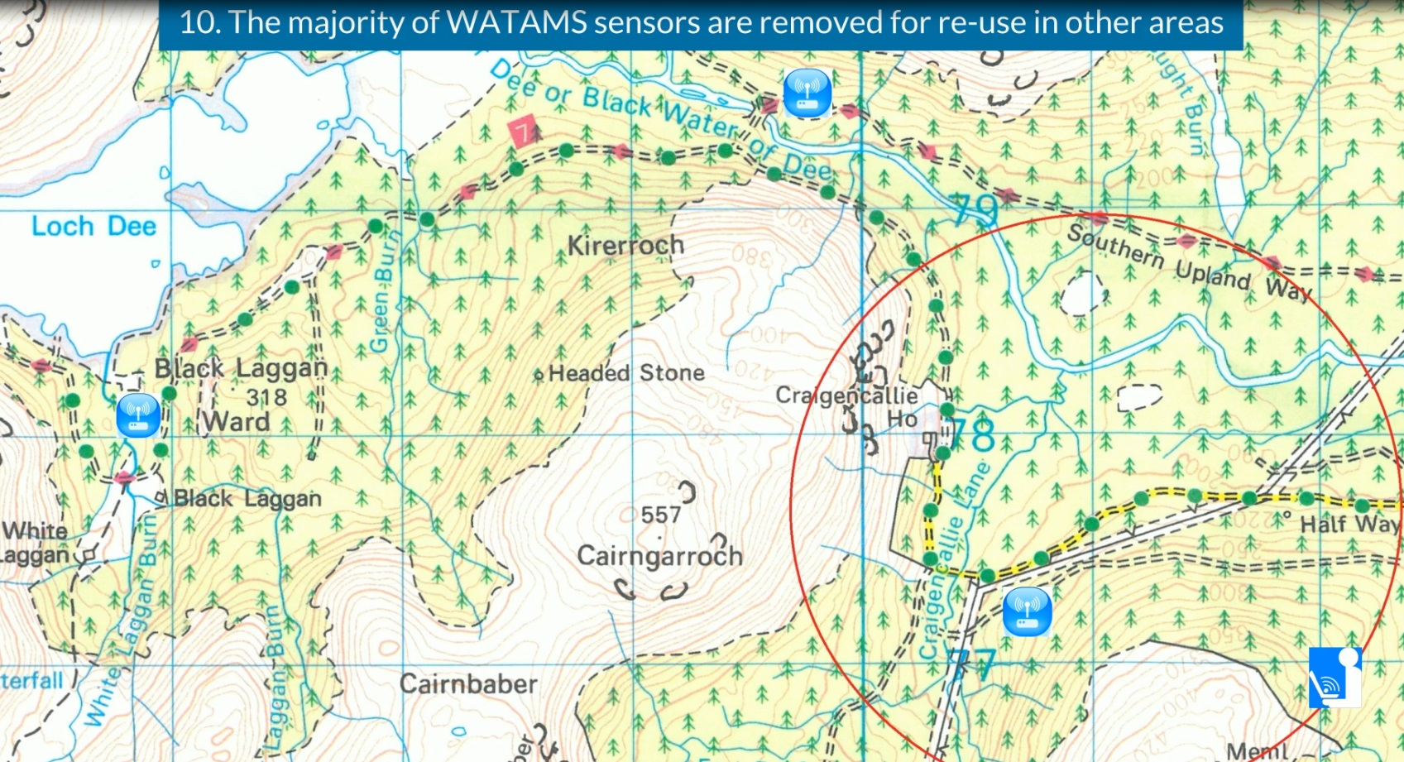
WATAMS sensors can be re-used in different woodland areas.

Slide 14
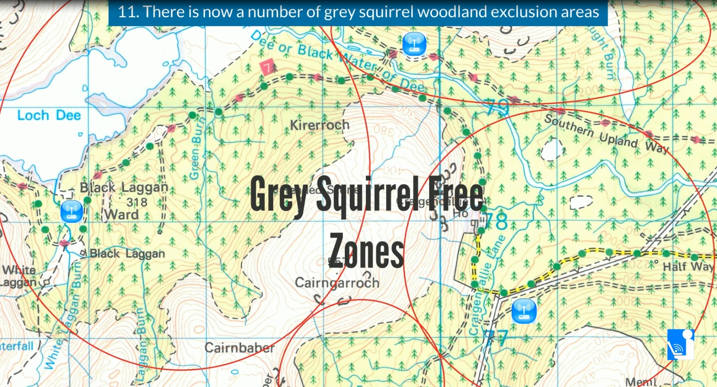
We now have a number of woodland areas cleared of grey squirrels. This process using WATAMS sensors can be continued indefinitely to further expand the exclusion zone area.

Slide 15
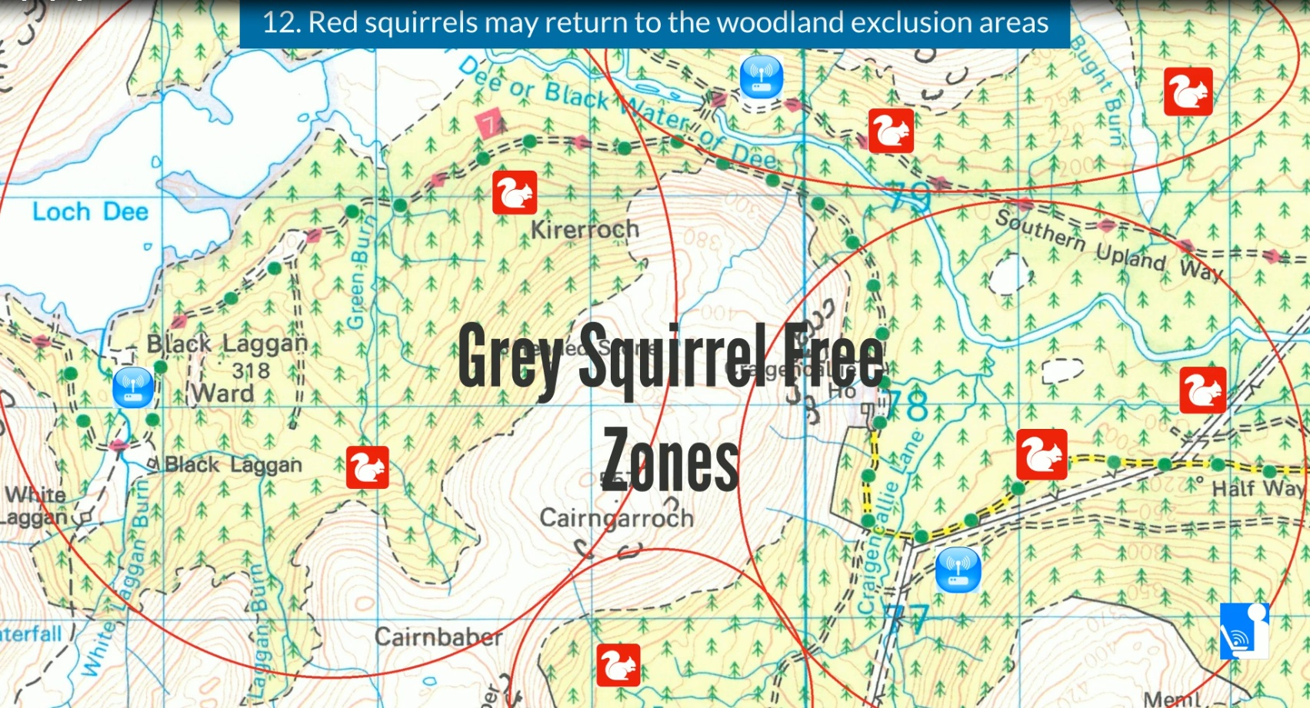
Now that the grey squirrels have been eradicated it is possible for red squirrels to return to the cleared and monitored woodland areas.

Slide 18
WATAMS can cover complex diverse and complex terrain by strategically adding stations based upon known animal behaviour and optimised capture patterns. Typical network layouts are shown.

