Slide 2
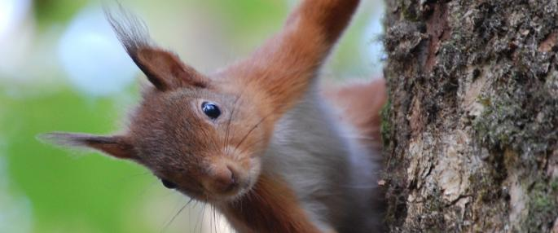
WELCOME TO NI

Slide 3
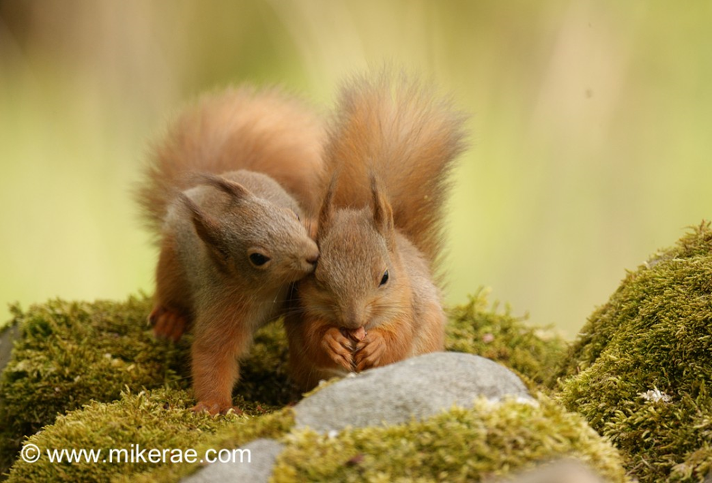
RSU – BUILT ON PARTNERSHIP

Slide 4
DAY 1: CULTRA MANOR

Slide 5
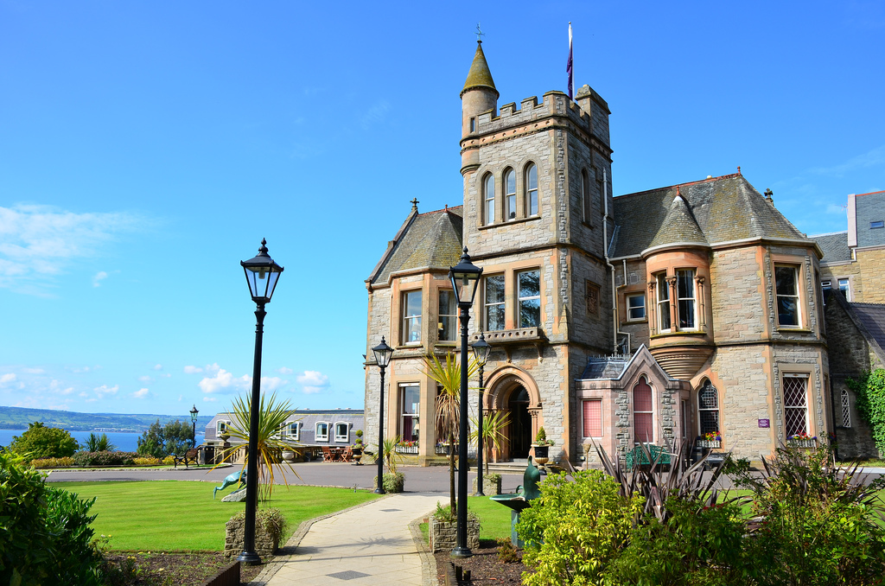
LOCAL HOSPITALITY – NOTHING BUT THE BEST!

Slide 6
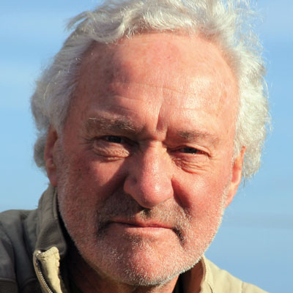
AFTER DINNER SPEAKER
BRIAN BLACK – UTV ENVIRONMENT CORRESPONDENT, INTERNATIONAL JOURNALIST ON CLIMATE CHANGE

Slide 7
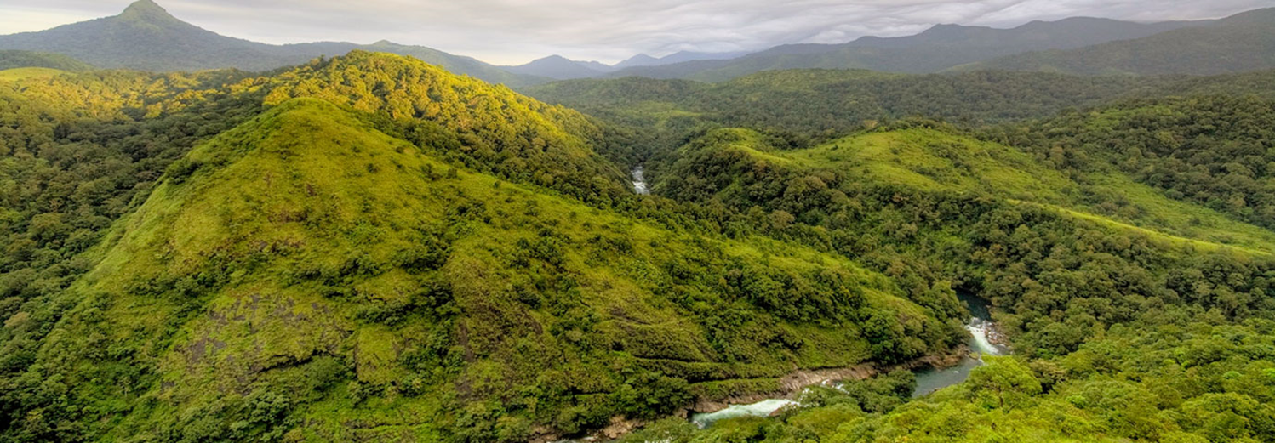
DAY 2 : FIELD VISIT SILENT VALLEY

Slide 8
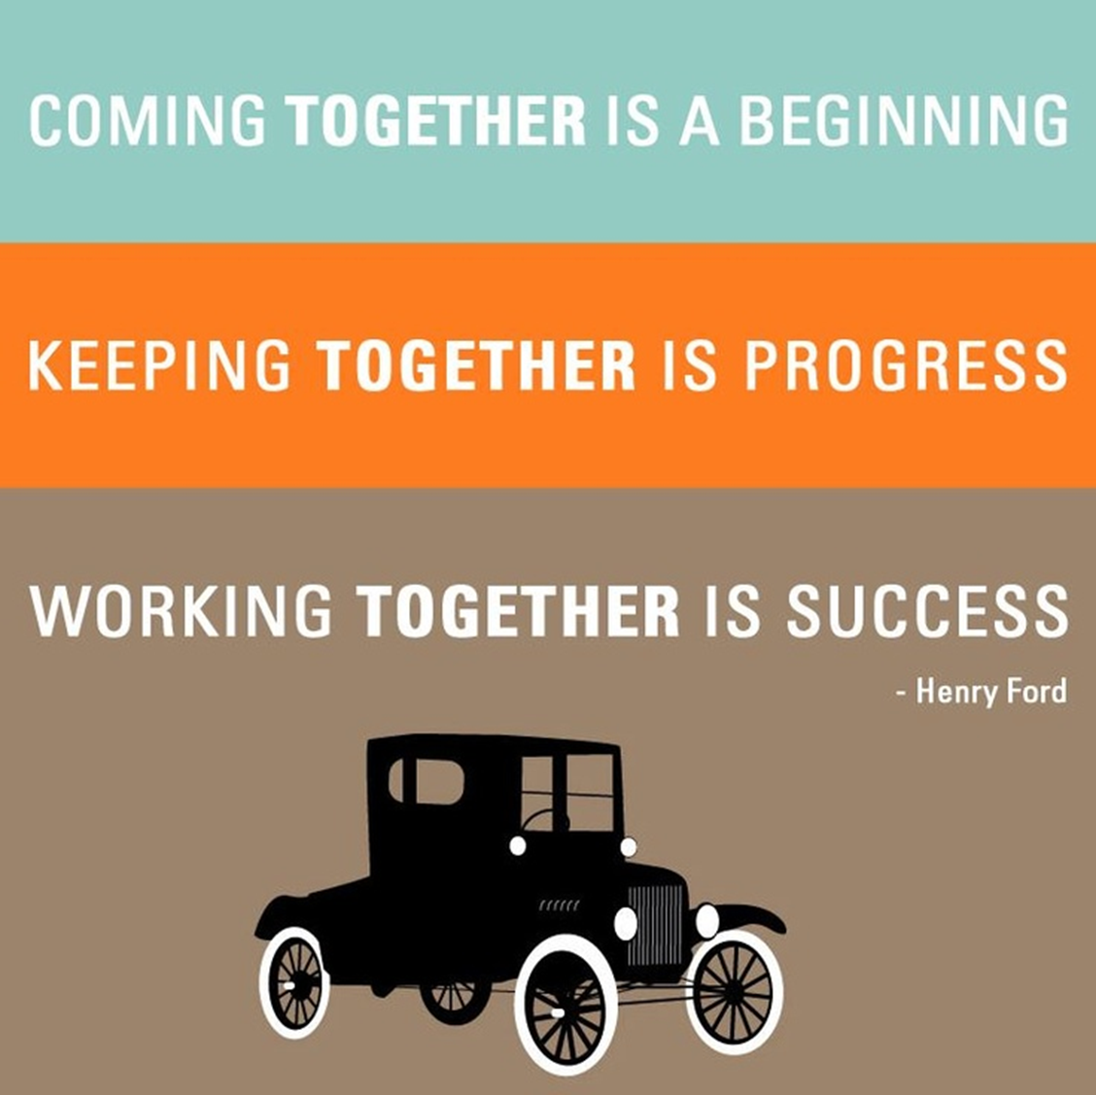
LOOKING FORWARD

