Slide 1
Red Squirrels United: a nationwide approach to red squirrel conservation
Dr Cathleen Thomas
The Wildlife Trusts

Slide 2
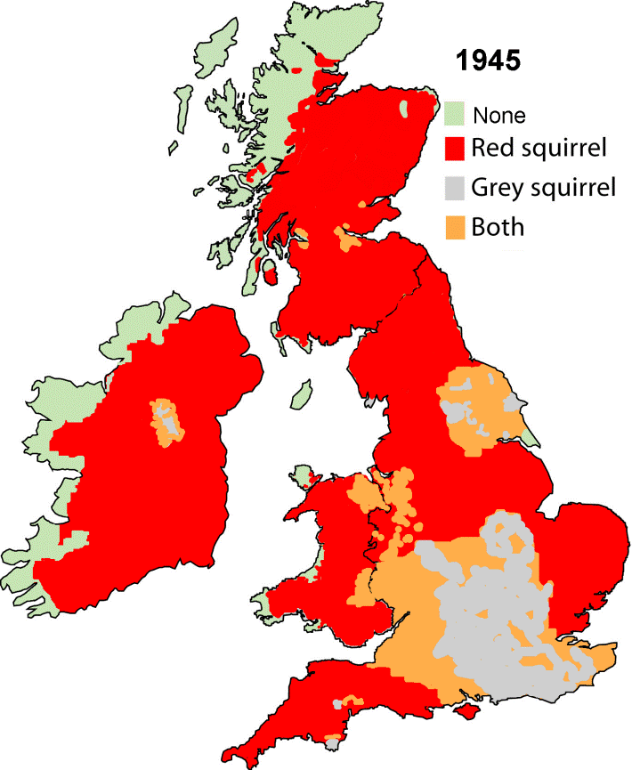
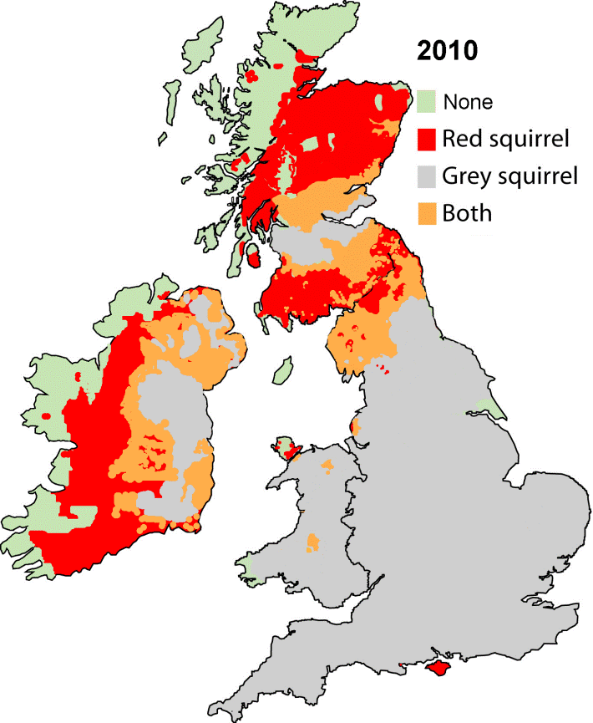
Squirrels in the UK
Once widespread across the UK, red squirrels are now facing extinction.
It is widely established that this is due to the introduction of the invasive non-native grey squirrel from North America in the late 1800s.
Greys directly outcompete reds for food and habitat and have replaced reds across much of their range.
Red and grey squirrel distribution in the British Isles in 1945 and 2010. Copyright Craig Shuttleworth/RSST
Notes:
Red squirrels are the only squirrel species native to the UK. Once widespread across the islands, they are now under threat of extinction as populations have declined rapidly since the introduction of the grey squirrel, which first came over in 1876. The larger, American, grey squirrel outcompetes the red squirrel for food and habitat, as well as carrying squirrel pox virus, which can kill red squirrels within a matter of weeks. Greys also live in much higher densities and cause considerable damage to tree bark. They feed on hazelnuts, which are also eaten by red squirrels and dormice.
It is estimated there are 140,000 red squirrels remaining in the UK.
Local and regional red squirrel conservation initiatives have made significant progress in halting the decline of the red squirrel populations and controlling the spread of grey squirrel populations. As the red squirrel populations begin to recover, it’s time to increase the scale of our work.
Constant conservation effort is likely to be needed for as long as grey squirrels are present nearby.

Slide 3
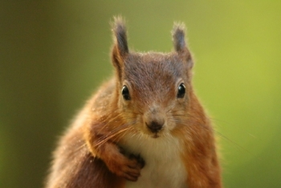
Red Squirrels United
The first UK-wide network working together to secure the future of our red squirrels, uniting 40 organisations across the UK and 5,000 volunteers.
The largest invasive species management programme in Europe, representing a significant investment by EU LIFE and HLF of ~£3 million.
A scientifically robust programme of conservation, protecting nine main stronghold red squirrel populations.
Notes:
RSU brings together community groups and conservation organisations.
The work being carried out by community groups is great, and the red is really starting to make a comeback, which makes RSU very timely as it’s time to unite and take a joined up approach if we want to really start to make a big difference across the UK.
This project is the first time we’ve made a joined up national effort towards conserving red squirrels. It is jointly funded by the European Commission as part of their LIFE programme for the environment and the National Lottery’s Heritage Lottery Fund for protecting the UK’s heritage.
Red Squirrels United is a scientifically robust programme of conservation, focussing around nine main stronghold areas of red squirrel populations.

Slide 4
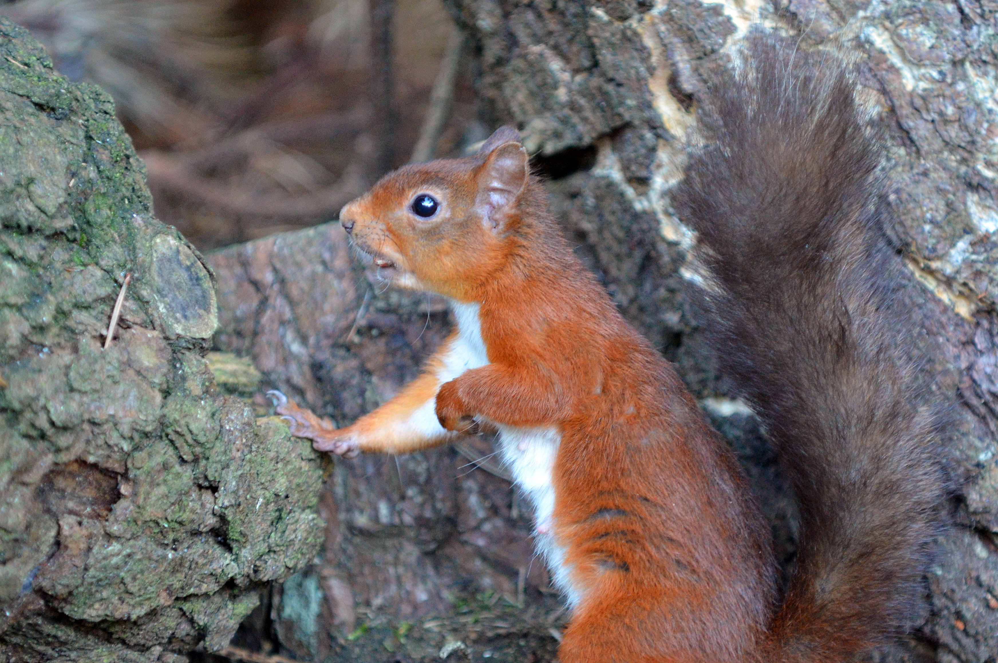
Red Squirrels United Mission
Support local communities carrying out red squirrel conservation.
Monitor squirrel populations and prevent the further spread of invasive non-native grey squirrels.
Underpin our conservation work with the latest scientific research.
Share knowledge and best practice on invasive species management.
Notes:
The work being carried out by community groups is great, and the red is really starting to make a comeback, which makes RSU very timely as it’s time to unite and take a joined up approach if we want to really start to make a big difference across the UK.
This project is the first time we’ve made a joined up national effort towards conserving red squirrels. It is jointly funded by the European Commission as part of their LIFE programme for the environment and the National Lottery’s Heritage Lottery Fund for protecting the UK’s heritage.
Red Squirrels United is a scientifically robust programme of conservation, focussing around nine main stronghold areas of red squirrel populations.

Slide 5
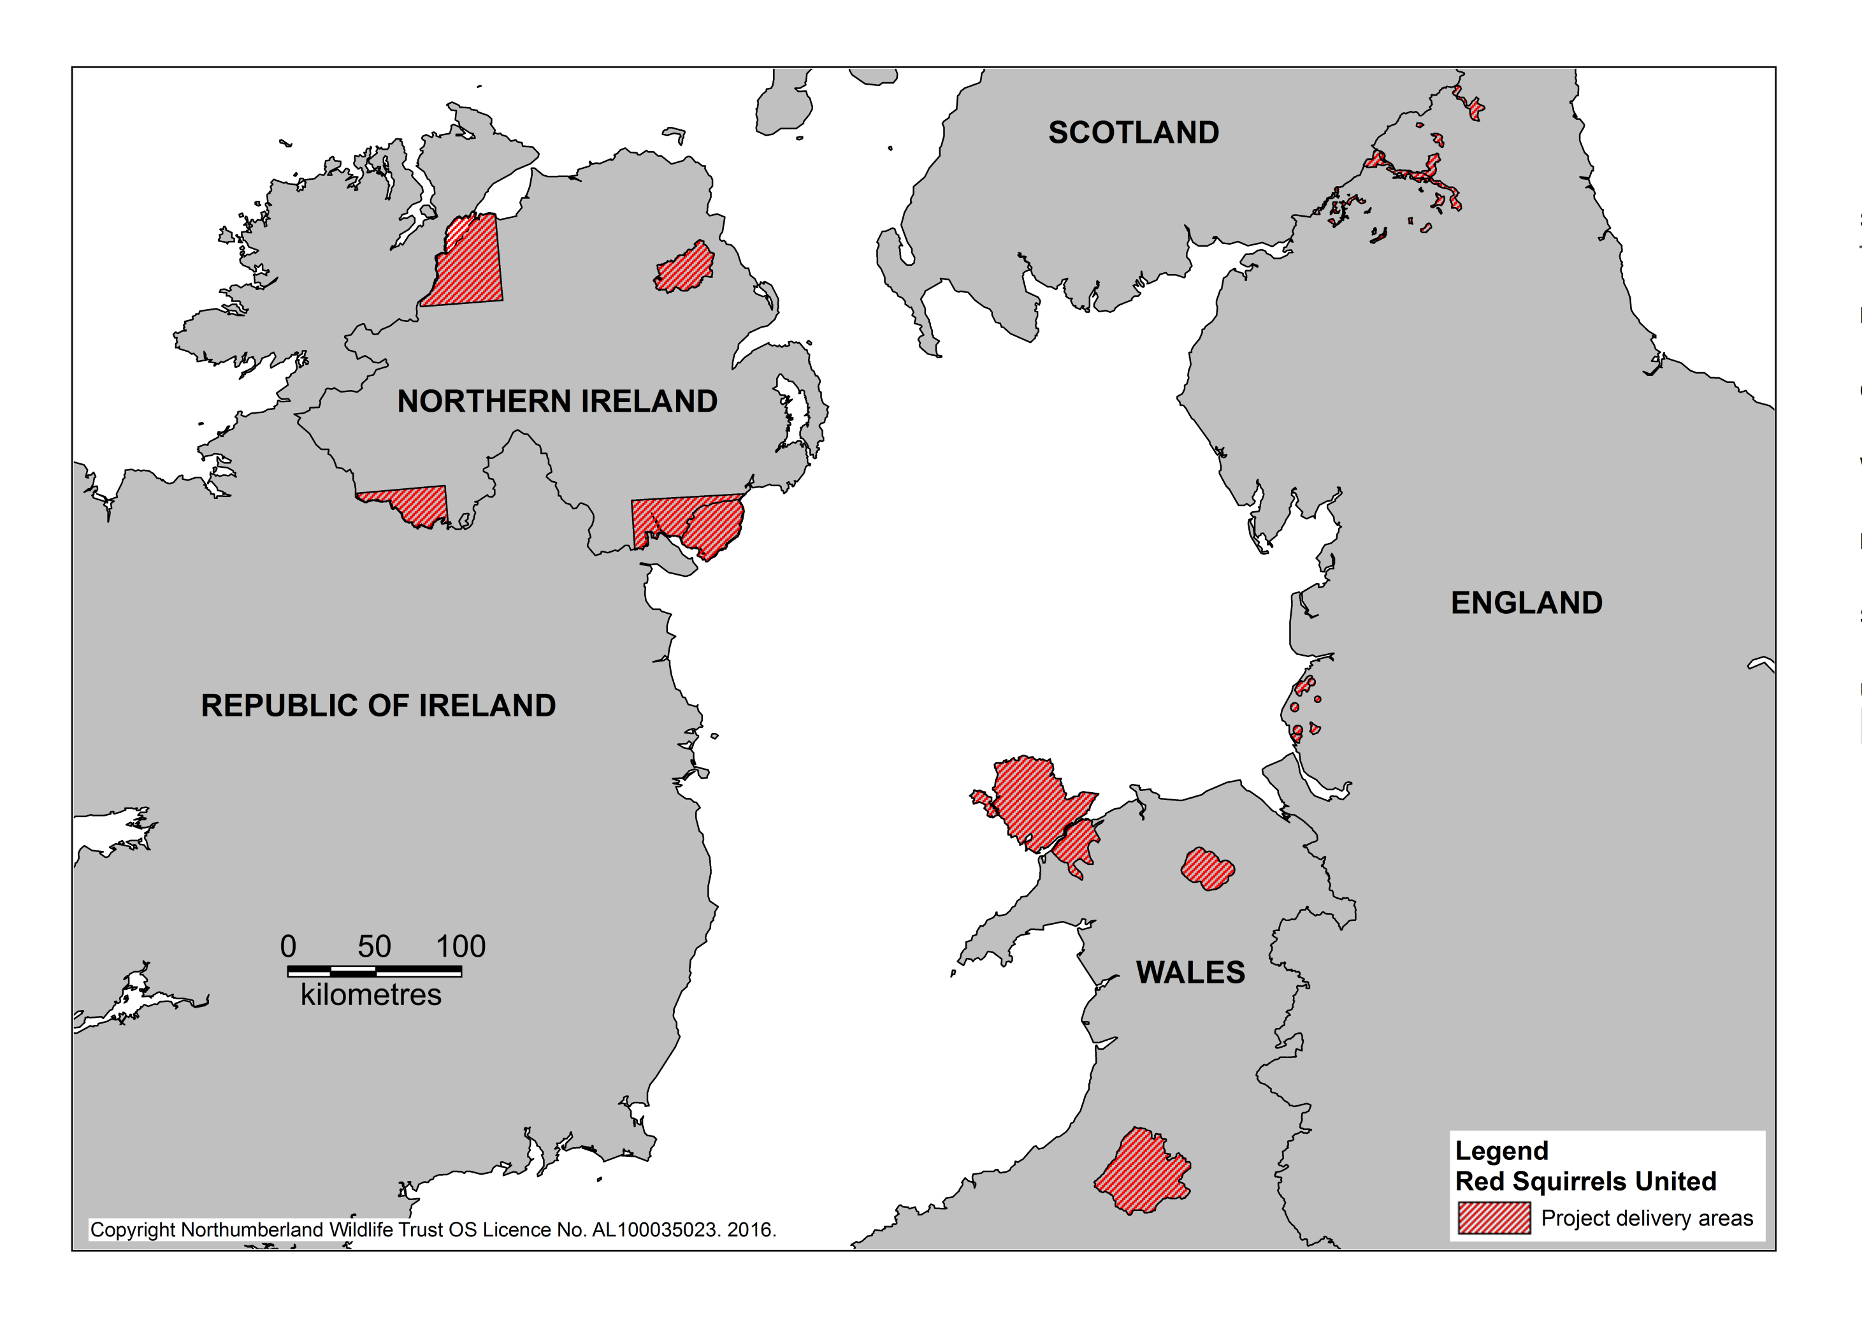
Red Squirrels United Conservation Areas
Notes:
This map shows the main conservation areas that we’re working in for Red Squirrels United. I’ll go round area by area to give a bit more information on the work we’ll be carrying out over the next three years.

Slide 6
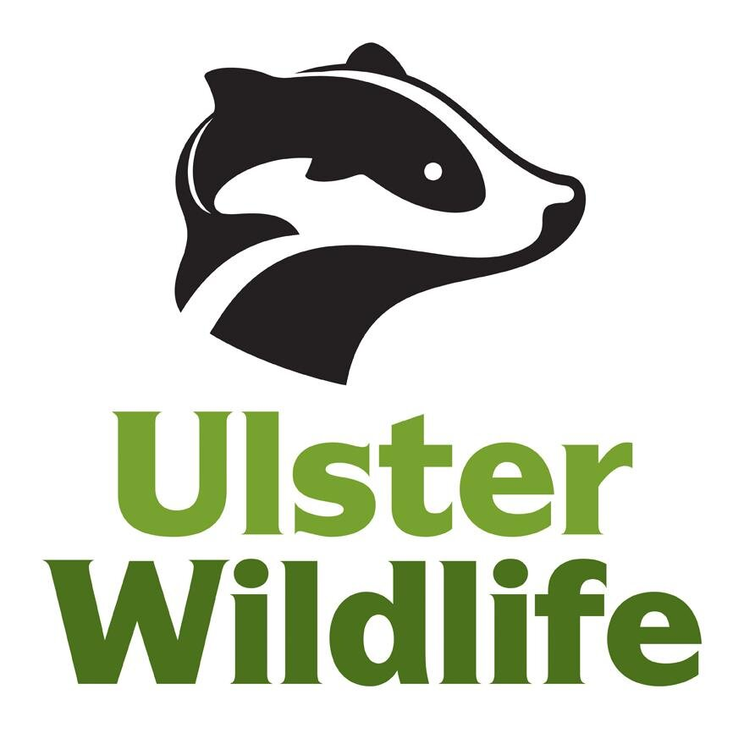
Northern Ireland
North West
Braid valley
Fermanagh
Mourne mountains
Notes:
Mourne mountains
It is likely that grey squirrels have entered this area from the north, as the Mourne Mountains and the sea form a natural barrier in other directions. Red Squirrels United is eradicating grey squirrels from the Mourne Mountains to provide a refuge for red squirrels.
Glens of Antrim
Red squirrel conservation is being carried out by volunteers in the Glens of Antrim. Red Squirrels United will provide them with additional support to enable continued grey squirrel management.
Fermanagh
Fermanagh holds the most westerly population of red squirrels in Northern Ireland. Red Squirrels United is raising awareness in this area through community engagement and support local volunteer groups.
North West of Northern Ireland
Red squirrel populations remain in Derry and Strabane. Red Squirrels United is recruiting volunteers to help with red squirrel conservation and providing support to establish local red squirrel groups.

Slide 7
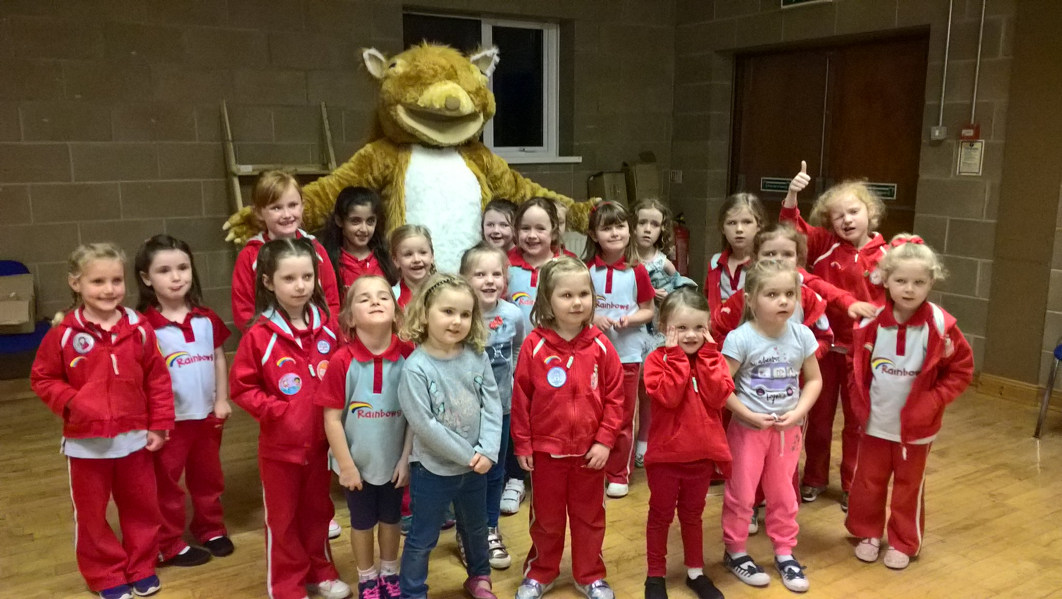
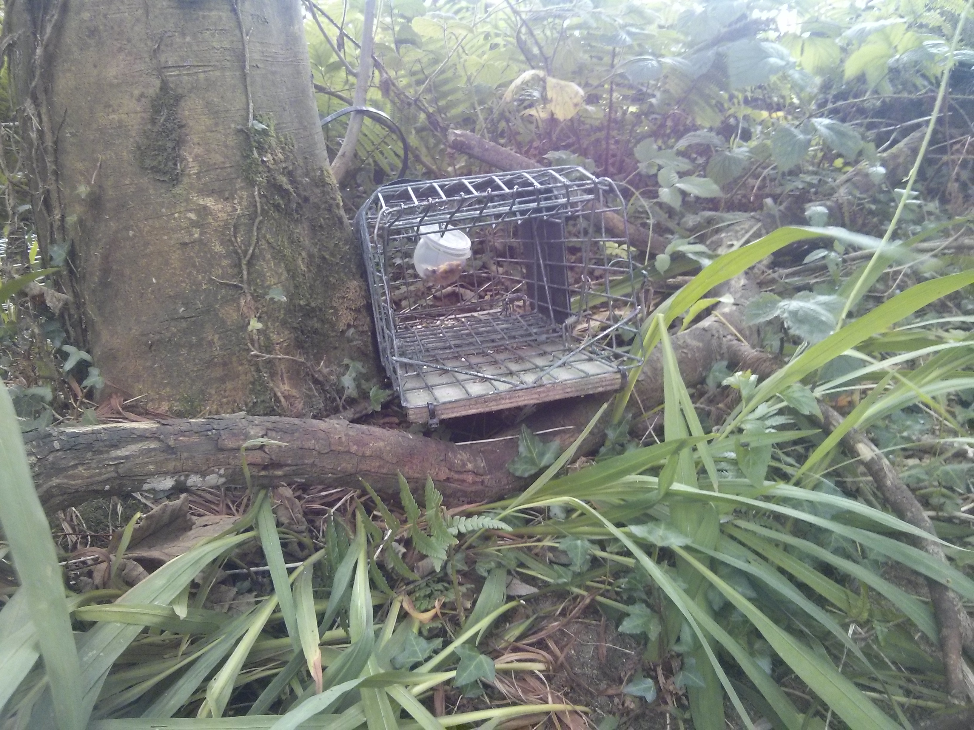
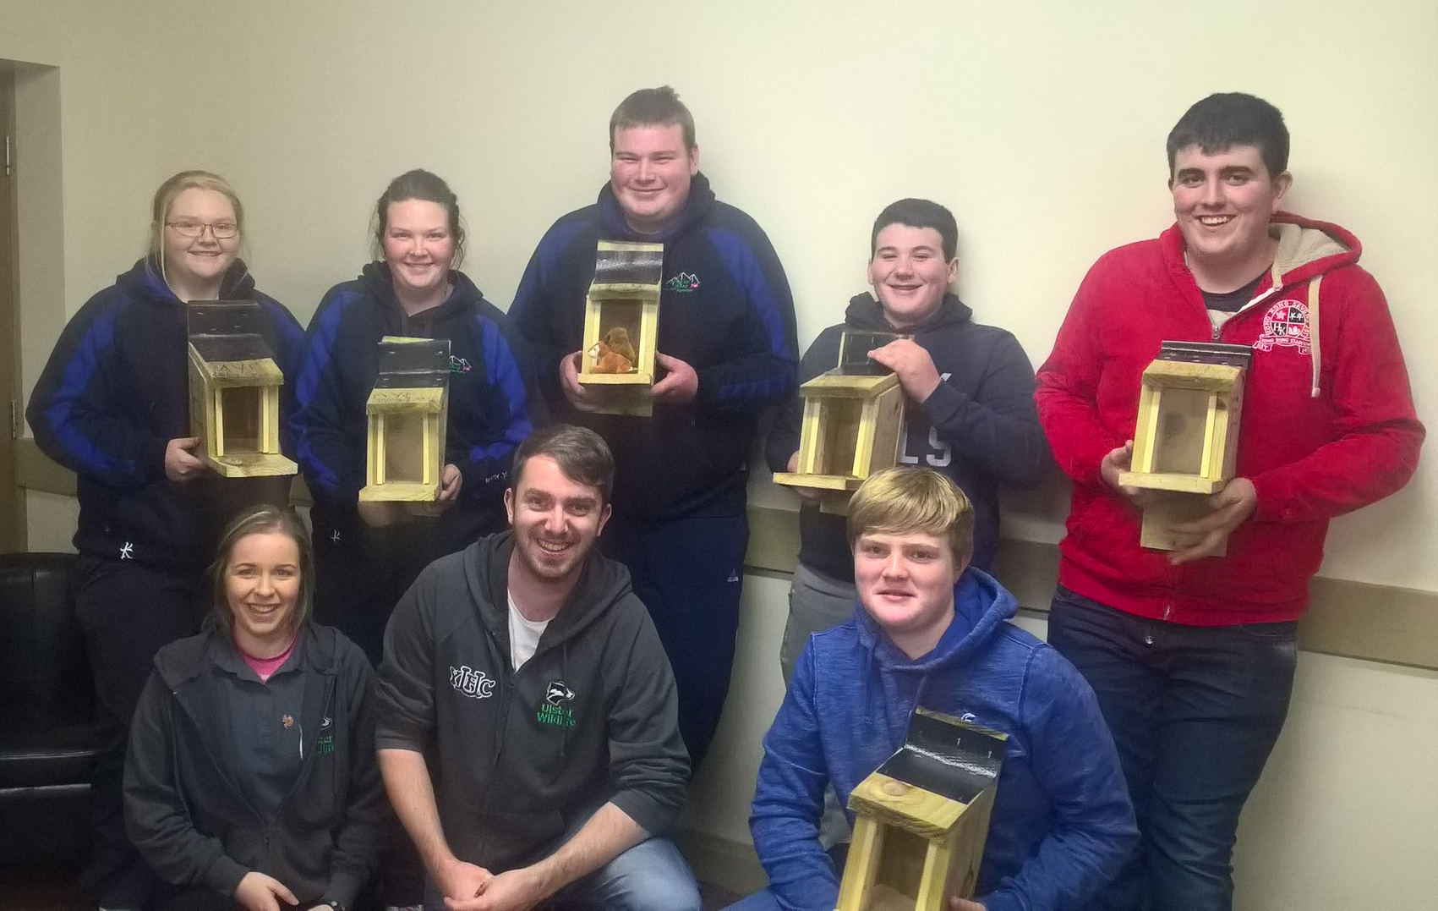
Northern Ireland
Notes:
Rainbows meeting Geoffrey the squirrel
Grassroots challenge with the young farmers
Trap

Slide 8
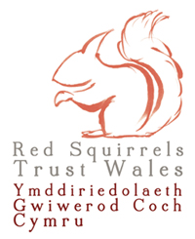
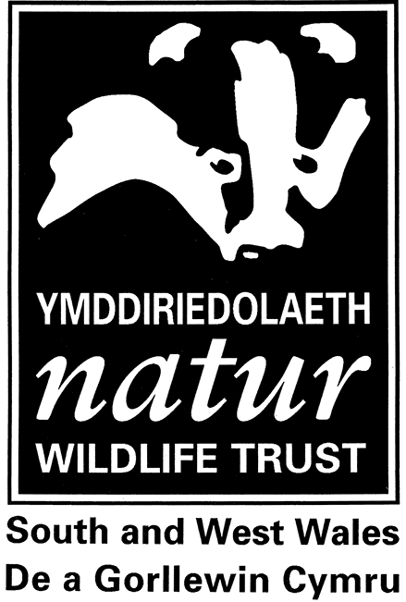
Wales
Anglesey and Gwynedd
Clocaenog
Tywi
Notes:
In Wales, there are 3 main focal areas.
Gwynedd
The Isle of Anglesey is the only Welsh county that does not contain grey squirrels following successful eradication. 60% of Welsh red squirrels are now found on the island and they are beginning to recolonise mainland woodlands. Red Squirrels United is supporting a new grey squirrel control effort in Gwynedd to prevent grey squirrels from recolonising the island and to allow the red squirrel population to expand.
Clocaenog
Clocaenog forest once held the largest population of red squirrels in Wales, but numbers have dramatically decreased. Red Squirrels United is focussing on community engagement to raise awareness of red squirrels and increasing the presence of red squirrels in the area through grey squirrel population management.
Tywi Forest
Tywi forest holds the last remaining red squirrel population in south Wales. Red Squirrels United is increasing the presence of red squirrels in the forest through grey squirrel population management and raising awareness of red squirrels through community engagement.

Slide 9
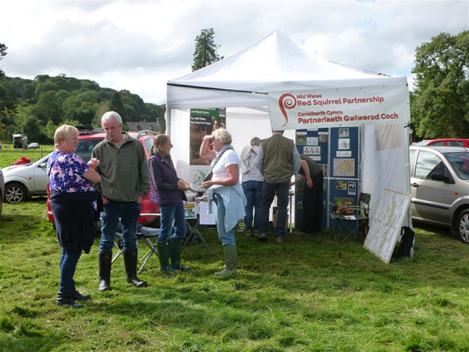
Wales
Notes:
Still from a camera trap
Mid Wales red squirrel partnership at a fair

Slide 10
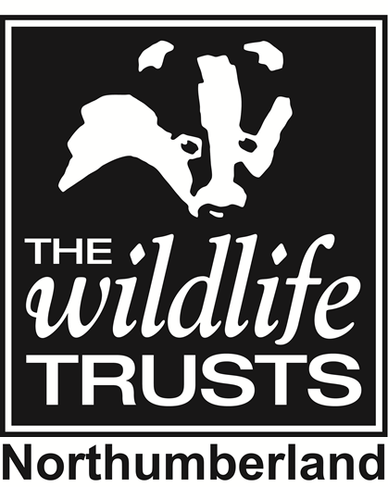
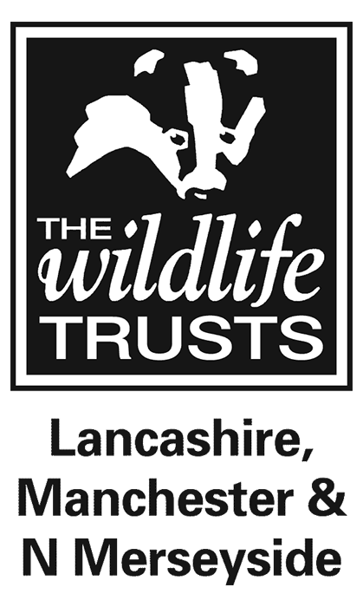
England
Kielder
Merseyside
Notes:
Kielder Forest
Kielder, Uswayford and Kidland forests are the only grey-squirrel free woodlands in England. Red Squirrels United is targeting their conservation work in this area to prevent colonisation of these woodlands by grey squirrels and protect red squirrel populations.
Formby
This isolated red squirrel population has expanded to the edges of Liverpool, Southport and Scarisbrick, greatly reducing their vulnerability to extinction. Red Squirrels United is managing grey squirrel populations in this area to benefit these red squirrels.

Slide 11
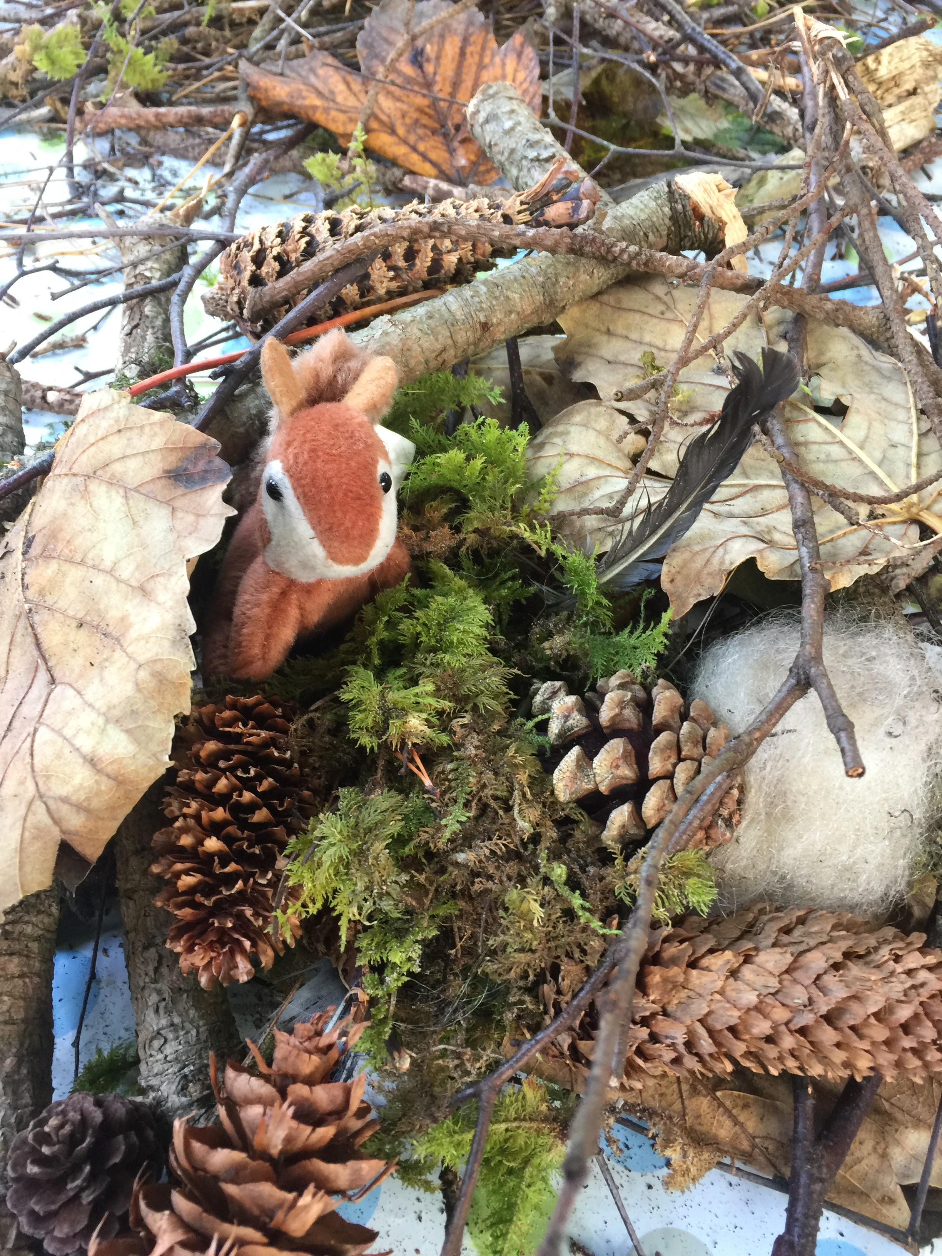
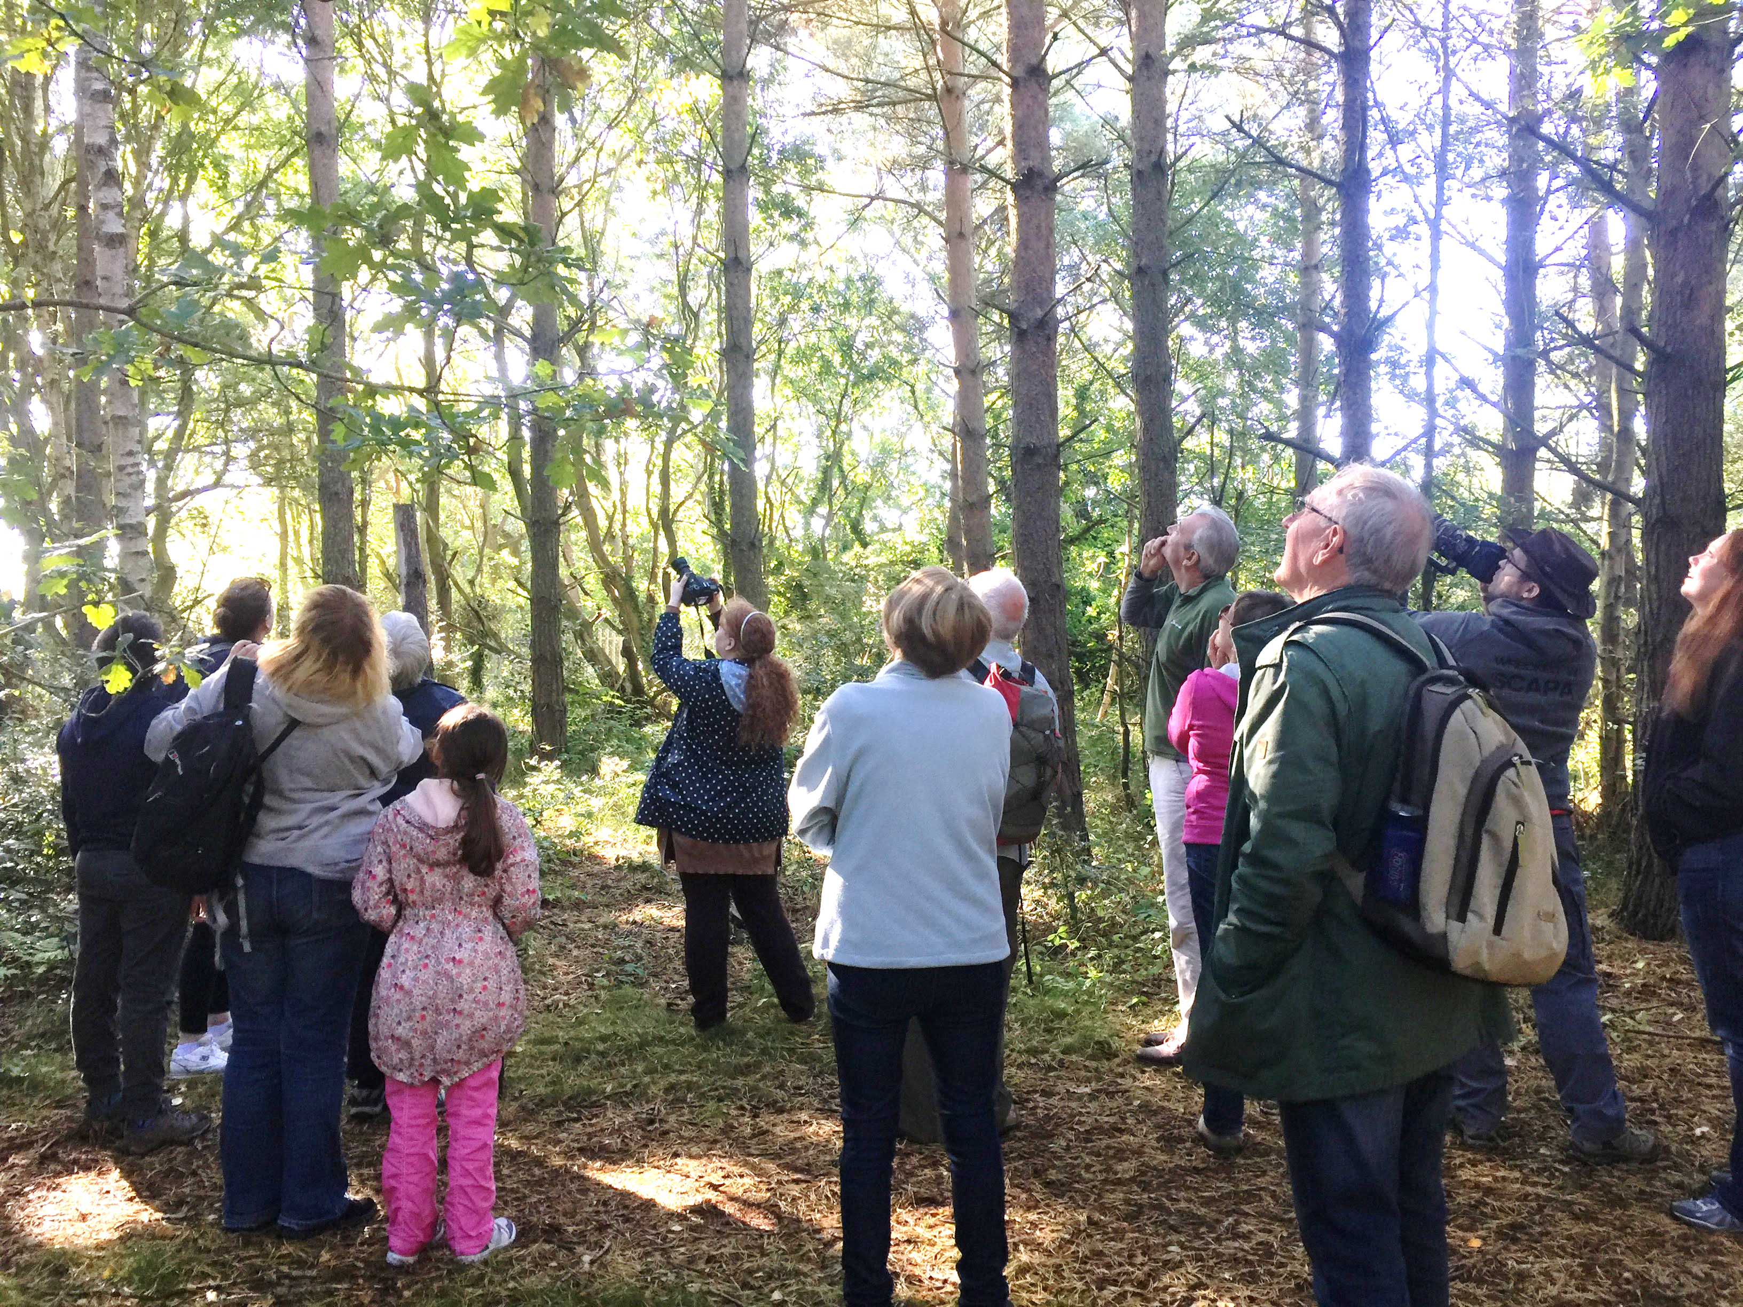
England
Notes:
Kielder Forest
Kielder, Uswayford and Kidland forests are the only grey-squirrel free woodlands in England. Red Squirrels United is targeting their conservation work in this area to prevent colonisation of these woodlands by grey squirrels and protect red squirrel populations.
Formby
This isolated red squirrel population has expanded to the edges of Liverpool, Southport and Scarisbrick, greatly reducing their vulnerability to extinction. Red Squirrels United is managing grey squirrel populations in this area to benefit these red squirrels.

Slide 12
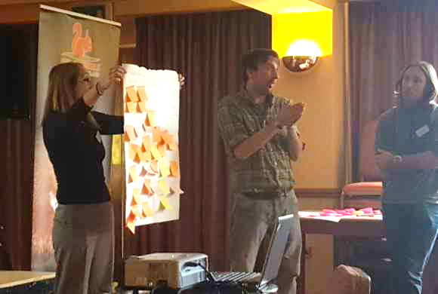
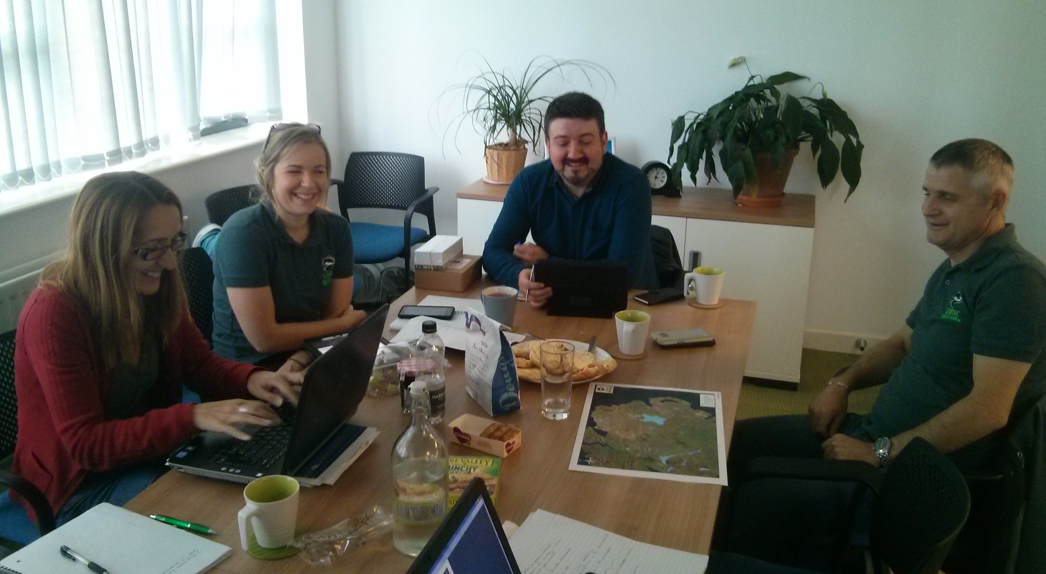
Red Squirrels United Research
Impact of grey squirrel management on public attitudes towards red squirrel conservation
Are they changing?
How can we better engage with people?
What recommendations do we have for future invasive species management?

Slide 13
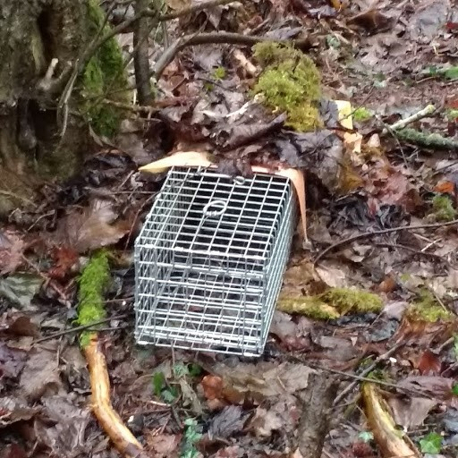
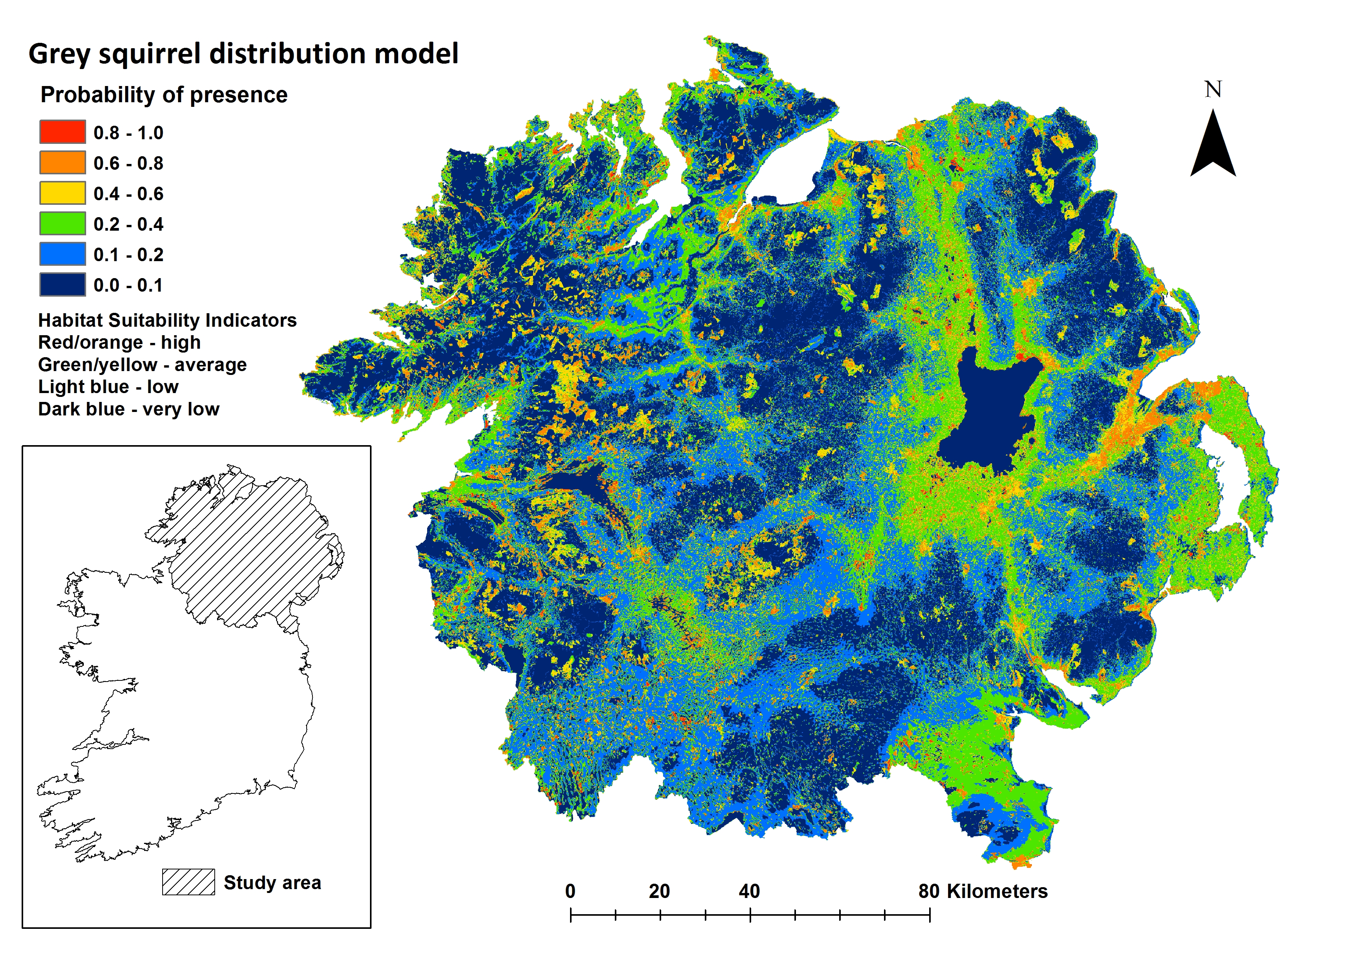
Red Squirrels United Research
Impact of grey squirrel management on red squirrel populations
What is the most effective way to trap grey squirrels?
Is our control work affecting grey squirrel populations?
What recommendations do we have for future invasive species management?

Slide 14
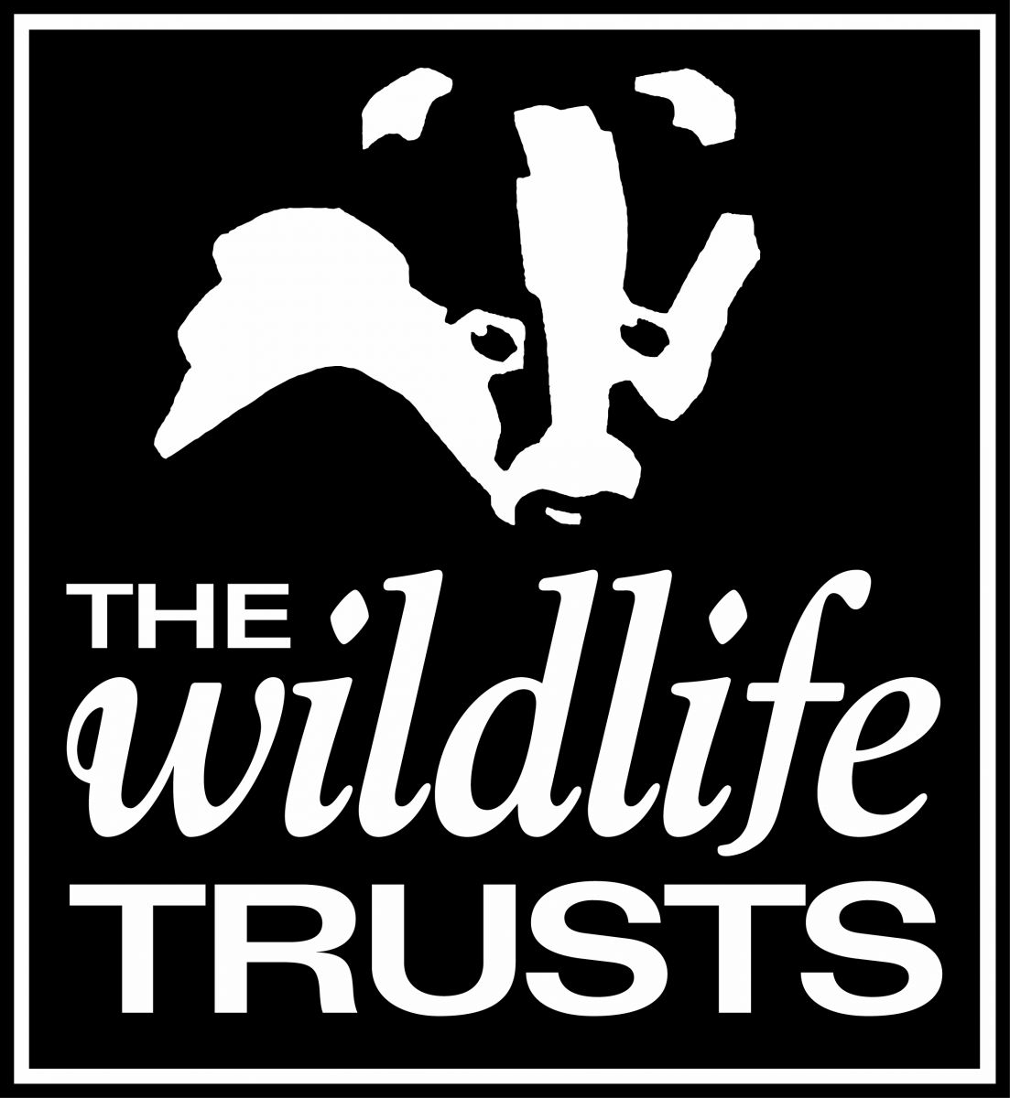
Red Squirrels United Communication
Visit us: www.redsquirrelsunited.org.uk
Follow us: www.facebook.com/RedSquirrelsUnited/
Tweet us: https://twitter.com/RedSquirrelsRSU
Meet us: Annual knowledge fairs

Slide 15
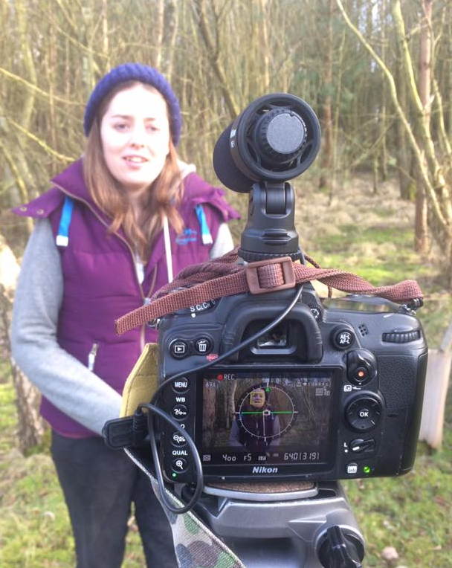
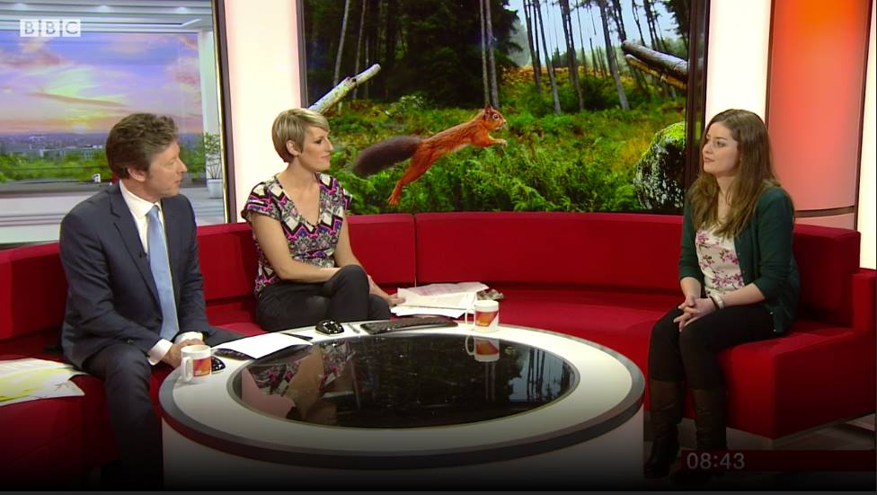
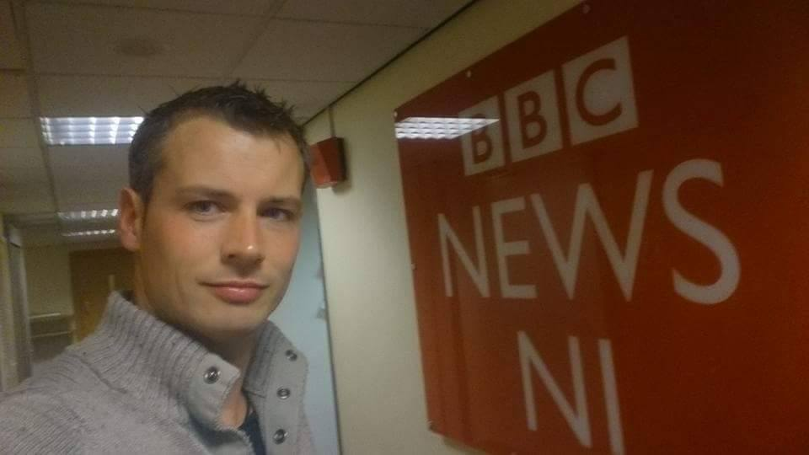
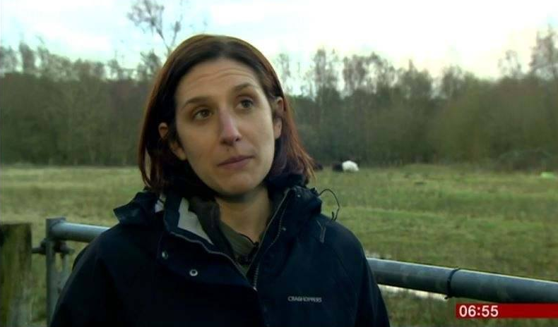
Red Squirrels United Media Coverage
National press campaign
Call for volunteers on 24/02/2017 gained national coverage:
BBC Breakfast, BBC News, ITV Good Morning Britain, ITV News, Sky News Sunrise, Channel Five News
BBC Radio 1, 2, 4, 5 live, World Service, Planet Rock
The Guardian, Daily Mail, Daily Express, Sunday Post, The Sun, The Times, Daily Telegraph, Metro, Washington Post
Inundated with requests for help and running out of woodlands!

Slide 16
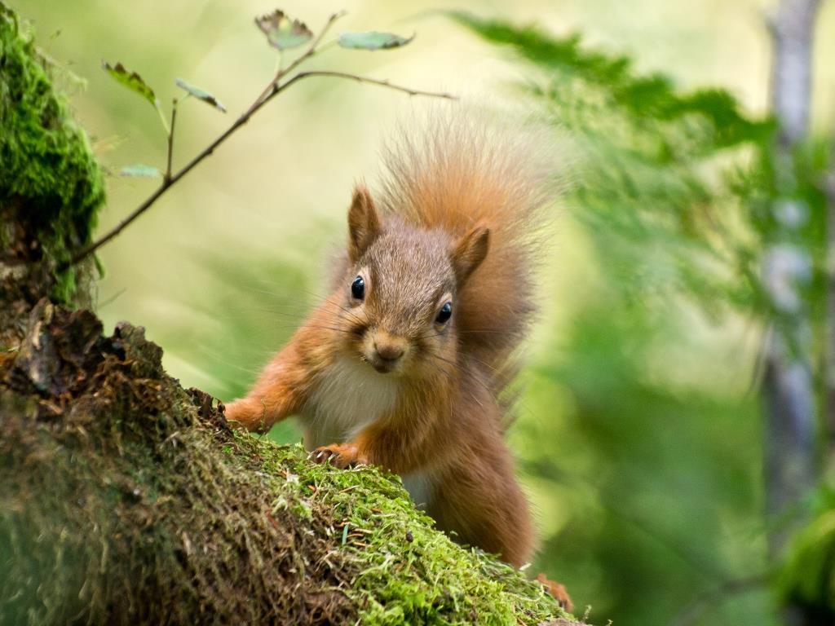
Thank you for listening
www.redsquirrelsunited.org.uk
cthomas@wildlifetrusts.org

