Slide 1
Data Collection and Citizen Science Red Squirrels United
Aileen Mill and Zelda van der Waal
Newcastle University
@RedSquirrelsRSU @aileencmill

Slide 2
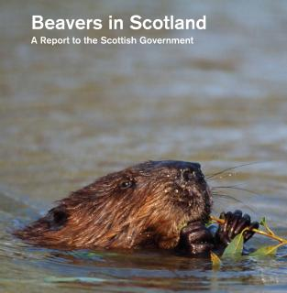
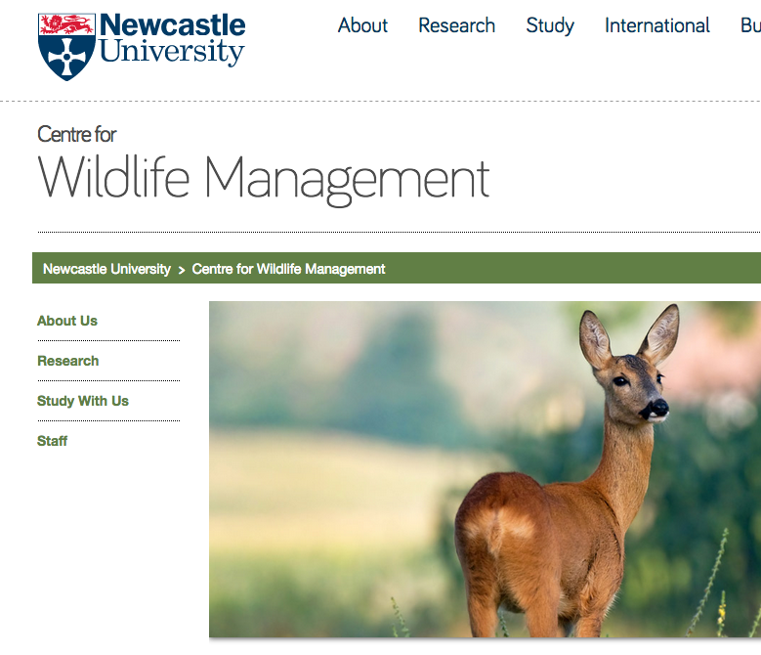
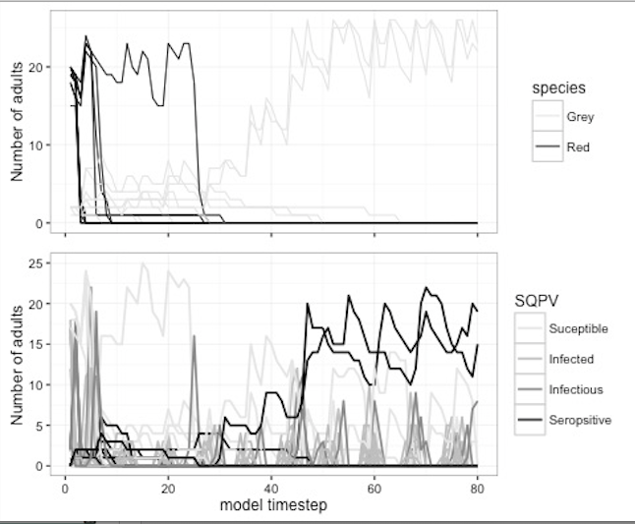
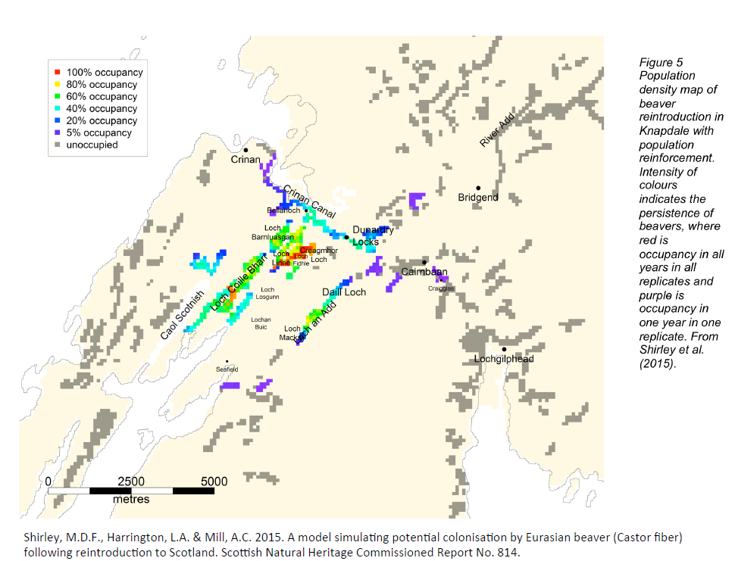
Novel research and the production of evidence to support action and its use in policy.
Invasive Non-Native Species
Wildlife Disease Ecology
Population Modelling
MSc Wildlife Management
Notes:
Add disease or ducks.

Slide 3
Our aims in Red Squirrels United Project
Determine how successful are we at :
Removing grey squirrels
Increasing number of reds
Use information to inform future management
Monitor disease in grey squirrels
When can we declare an area free of grey squirrels?
What level of effort do we need to maintain a buffer zone?
To do this we need specific data collected in a standard, consistent format.
Notes:
Collate conservation actions into something measureable.
Useful to measure degree of success
Inform action elsewhere
Aim here is to explain WHY we need this data.
Recording data – Why. Compare across sites
Recording data – How . Standardisation. Vision of digital future ( need to determine what is needed
Time and Space
Effort

Slide 4
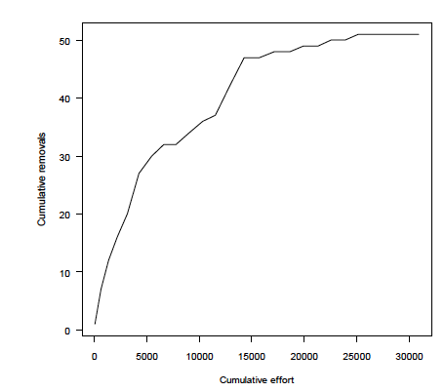
Catch per unit effort
Animals culled (removed)
Effort (trap events)

Slide 5
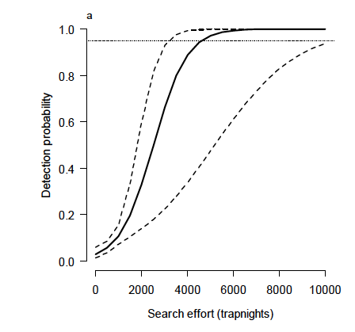
Effort
Ramsey et al (2011)

Slide 6
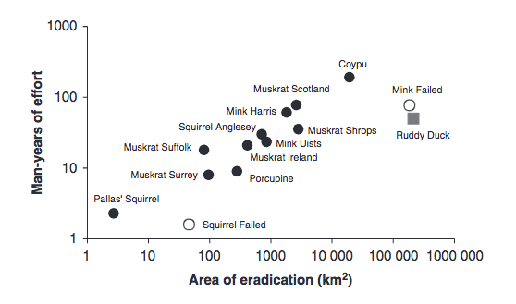
Effort
Robertson et al 2016
Notes:
First we took a look at control of invasive mammals elsewhere. Much of the work has been done on islands, that have clear boundaries which makes eradication much more feasible and easily determined. We have collated data from 11 non- island >xxxkm to determine the man effort required for eradications. Also compared costs…. Inline with islands – therefore predicatable. This focussed on one elemeent of invasive species control – eradication but for many areas this is not a realistic opportunity........

Slide 7
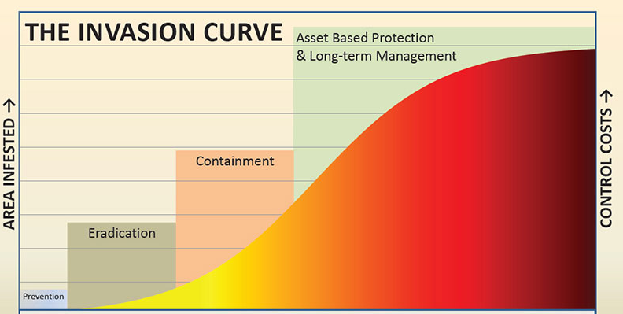
Invasive Species Management
Early Warning
Systematic monitoring
Grey Squirrel control
Notes:
If we look at the process of invasion in terms of area and costs to control we see… 4 stages of the process. If we thingk of our local project areas rather than the grey swuirrel in the UK as a whole, Across the RSU project we have areas that fall into each of these areas of the curve. E.g. Core of keilder we are aiming at Preventions – early warning.
In Wales and the mournes – eradication – the early warning for reinvasion ( as is case on anglesey – public sightings are important)
In Merseyside is ocntainment – keep them out of the areas with reds..... Need for constant control of greys.
Activities to allow the conservation actions to work toward the pillars of invasive species control, depending on the area, prevent ingress/ range control, reduction and eradication. For all of these objects data on squirrels sightings, range monitoring and control need to be undertaken. All of which volunteers can participate in.

Slide 8
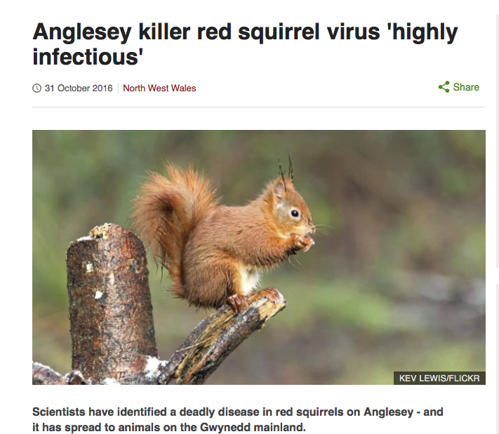
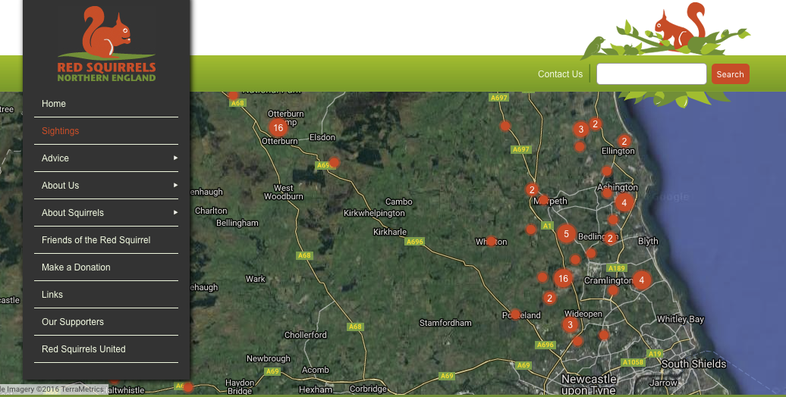
Red Squirrels United – Sightings data
Sightings data are important to inform action
Early warning system
Disease outbreaks
Notes:
Anglesey experience
Paper BBC articles

Slide 9
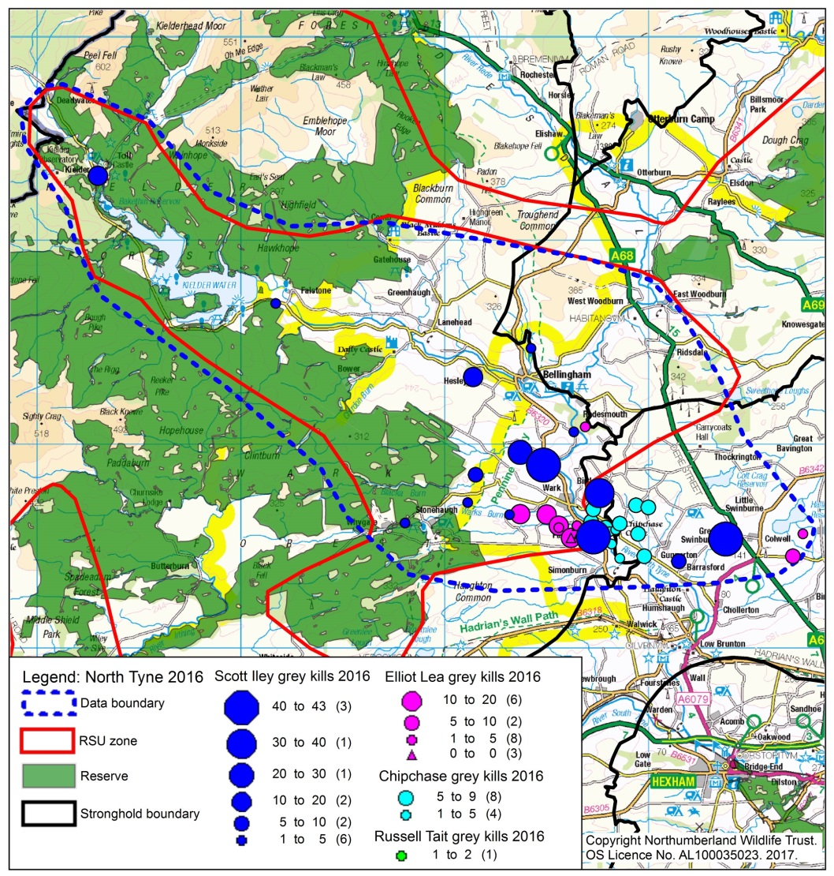
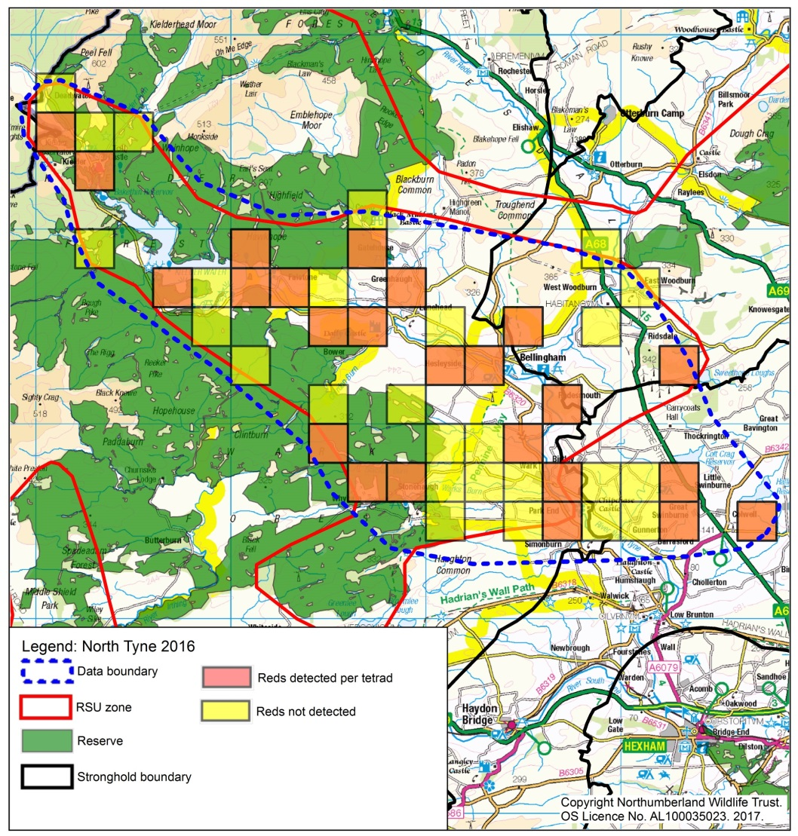
Monitoring Data
Why Important?
Standardised
We can map squirrel distribution
Can be repeated through time
How can we improve?
Estimate abundance/density
Record Effort to Detect Squirrels
Notes:
Density and abundance are harder to do in the field but with the trapping data we can make models to predict this – moving from the coloured in squares to something more meaningful for future management

Slide 10
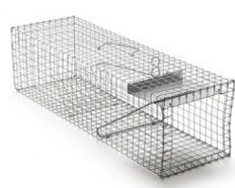
How to we measure success at grey culling?
Metrics:
Number of grey squirrels culled.
Number of traps set
Number of man-hours in the field
BUT Time and Space are very important
Number of grey squirrels culled from my 100 acre wood
Number of grey squirrels culled from my 100 acre wood over 1000 trap nights
Notes:
Man hours can vary for a huge number of reasons – including the first two above. At the beginning the efficiency will be higher than at the end of a culling period…... Not a great measure – time spendt out may feel wasted but if you caughthe last squirrels. ....
Effort
How many are left? Depends how many were there to start with. Can we estimate this? Yes, we can try.

Slide 11
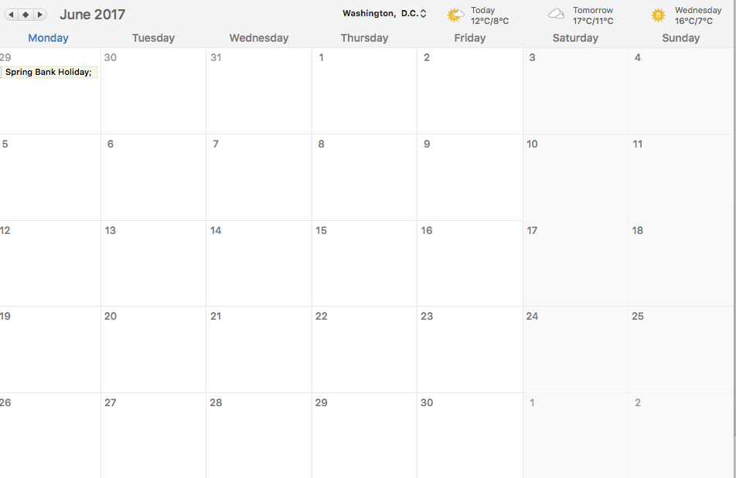
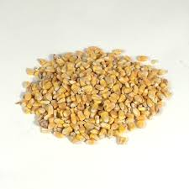
Reporting effort: recording time
Start day 2/07/16
End date 30/07/16
Trapping session 28 days
4 trap days
Notes:
Change to effort in time

Slide 12
Reporting effort: recording time
Start day 2/07/16
End date 30/07/16
Trapping session 28 day
4 trapping sessions
8 trap days
Notes:
Change to effort in time

Slide 13
Reporting effort: recording time
Start date 5/07/16
End date 9/07/16
Trapping session 5 days
Start date 12/07/16
End date 16/07/16
Trapping session 5 days
Notes:
Change to effort in time

Slide 14
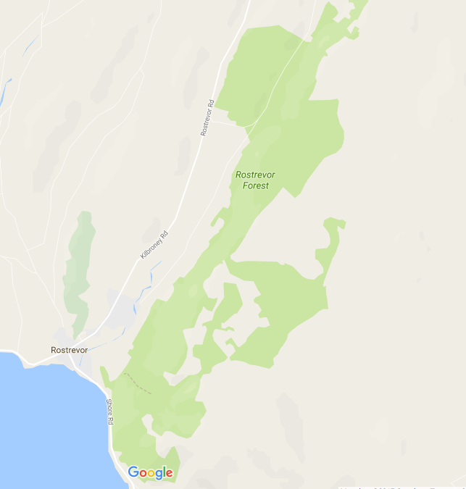
Control Effort in Space

Slide 15
Control Effort in Space

Slide 16
Control Effort in Space

Slide 17
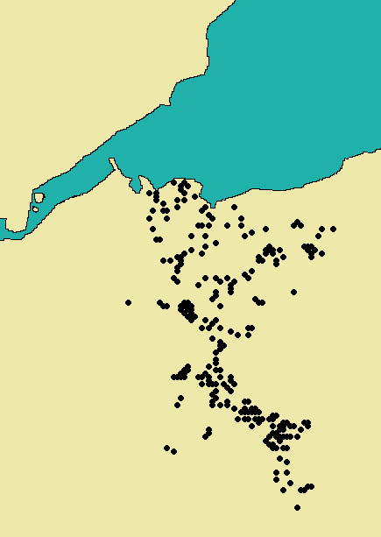
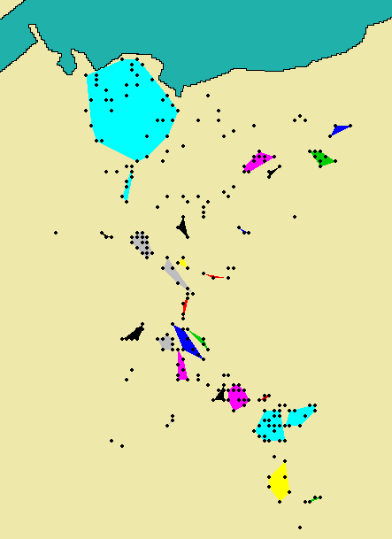
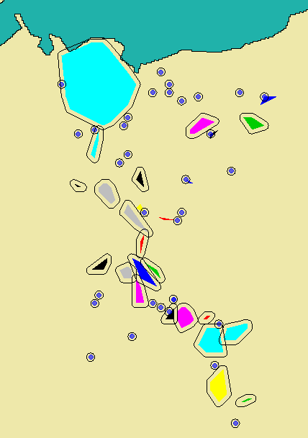
Control Effort in Space
Points for trap locations | Points for trap locations + area for each trapping session
GPS coordinates for all traps in each session
Total area + number of traps is needed for each trapping session
Notes:
Include number f traps and the difference in spacing and density.

Slide 18
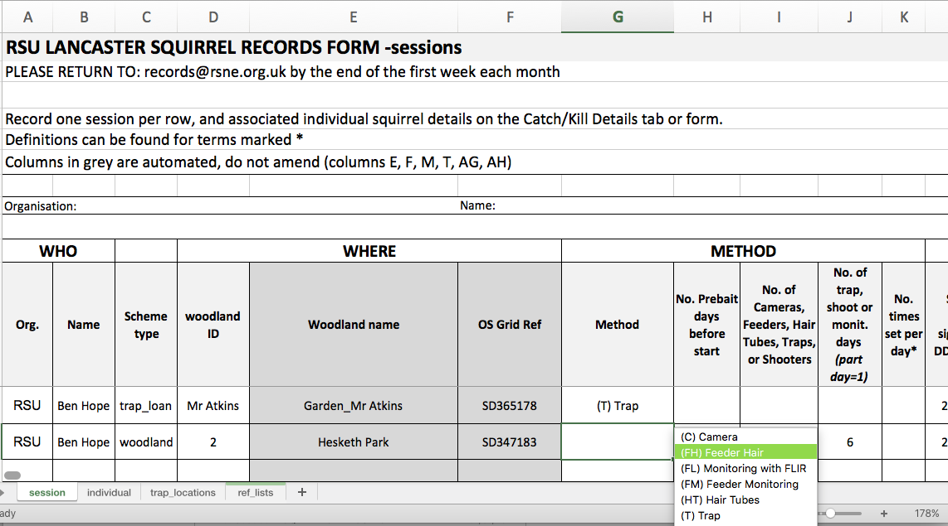
‘Clean’ and timely data
Simple adaptations to existing recording sheets: drop-down menus, in-cell data validations
Digitize data on a weekly basis, detect issues early
Notes:
Drop-down menus and lists
drop-down menus are in a cell, they contain a list of the options relevant to this particular cell
so options are limited, which reduces typos, variations etc
Move towards digital data capture – first step is determining qwhat we need to recrd/.
Example: drop-down menu for method allows selecting amongst a pre-determined list of methods.
Example: select woodland ID in drop-down menu; associated grid reference and woodland name are automated (columns C and D in grey), no need for data entry
Based on this list, all site variables can be retrieved (habitat, distance to other woodlands etc). Those data don’t need to be on the record sheet but are available to partners.
All those formatting features are specific to each site so they need to be tried out..

Slide 19
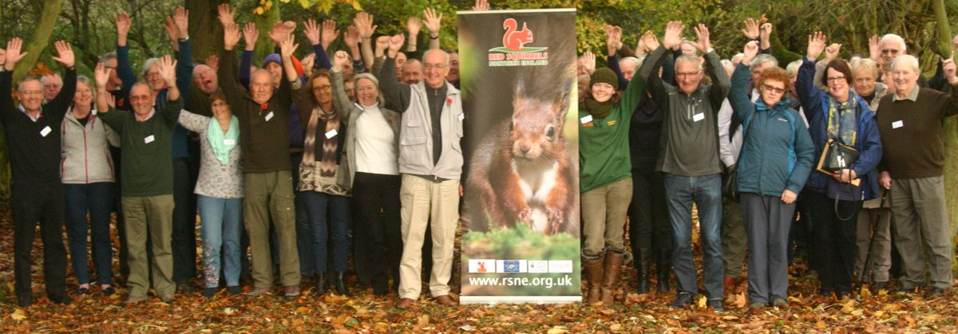
Red Squirrels United – Data Provision
Improve recording to include effort in space and time
Standardised recording formats
Explore the use of digital data capture
Notes:
Working with partners to standardise data formatting across the project areas, this includes volunteer data provision. Main problem is that battling with excel is the last thing volunteers wish to do – moving to app based reocrding, not without its own problems. Improve data consistency

Slide 20
Removal Models
Are there likely to be any greys left in my woodland?
How much effort (trap nights) will I need to apply to remove them?
Closed
Open

