Slide 1
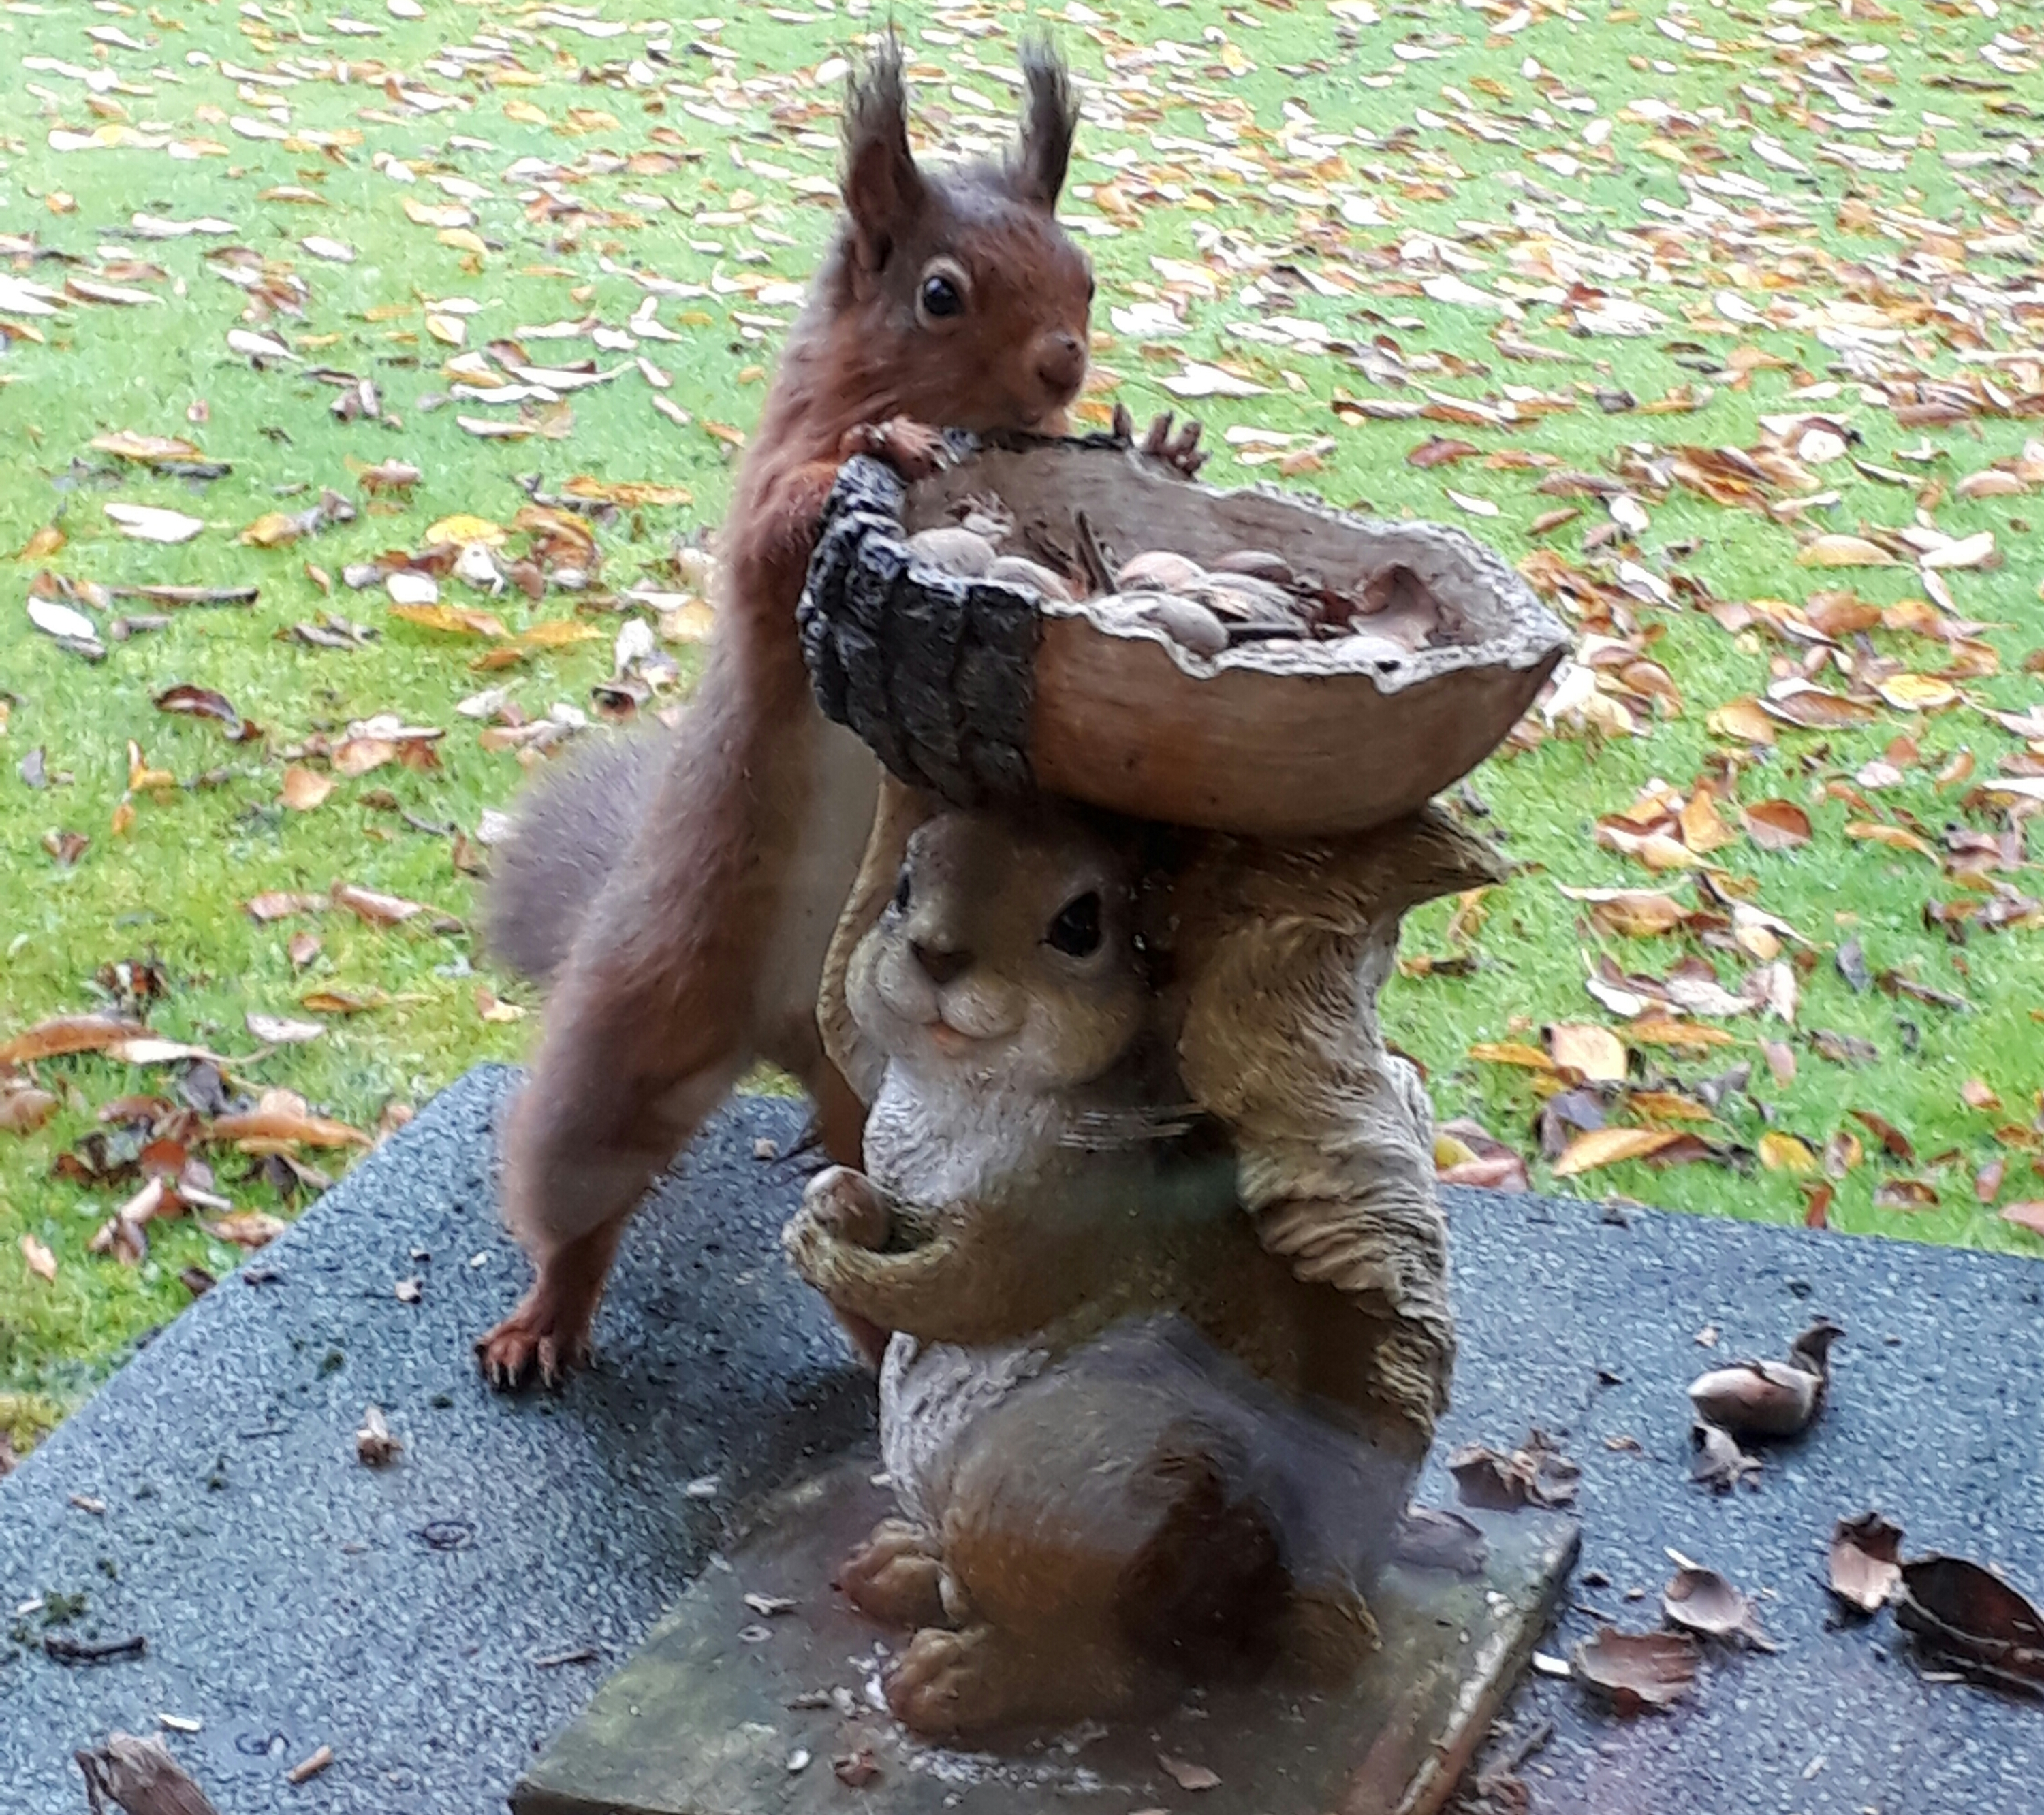
Julie Bailey & Peter Armstrong Bangor RSU Knowledge Fair

Slide 2
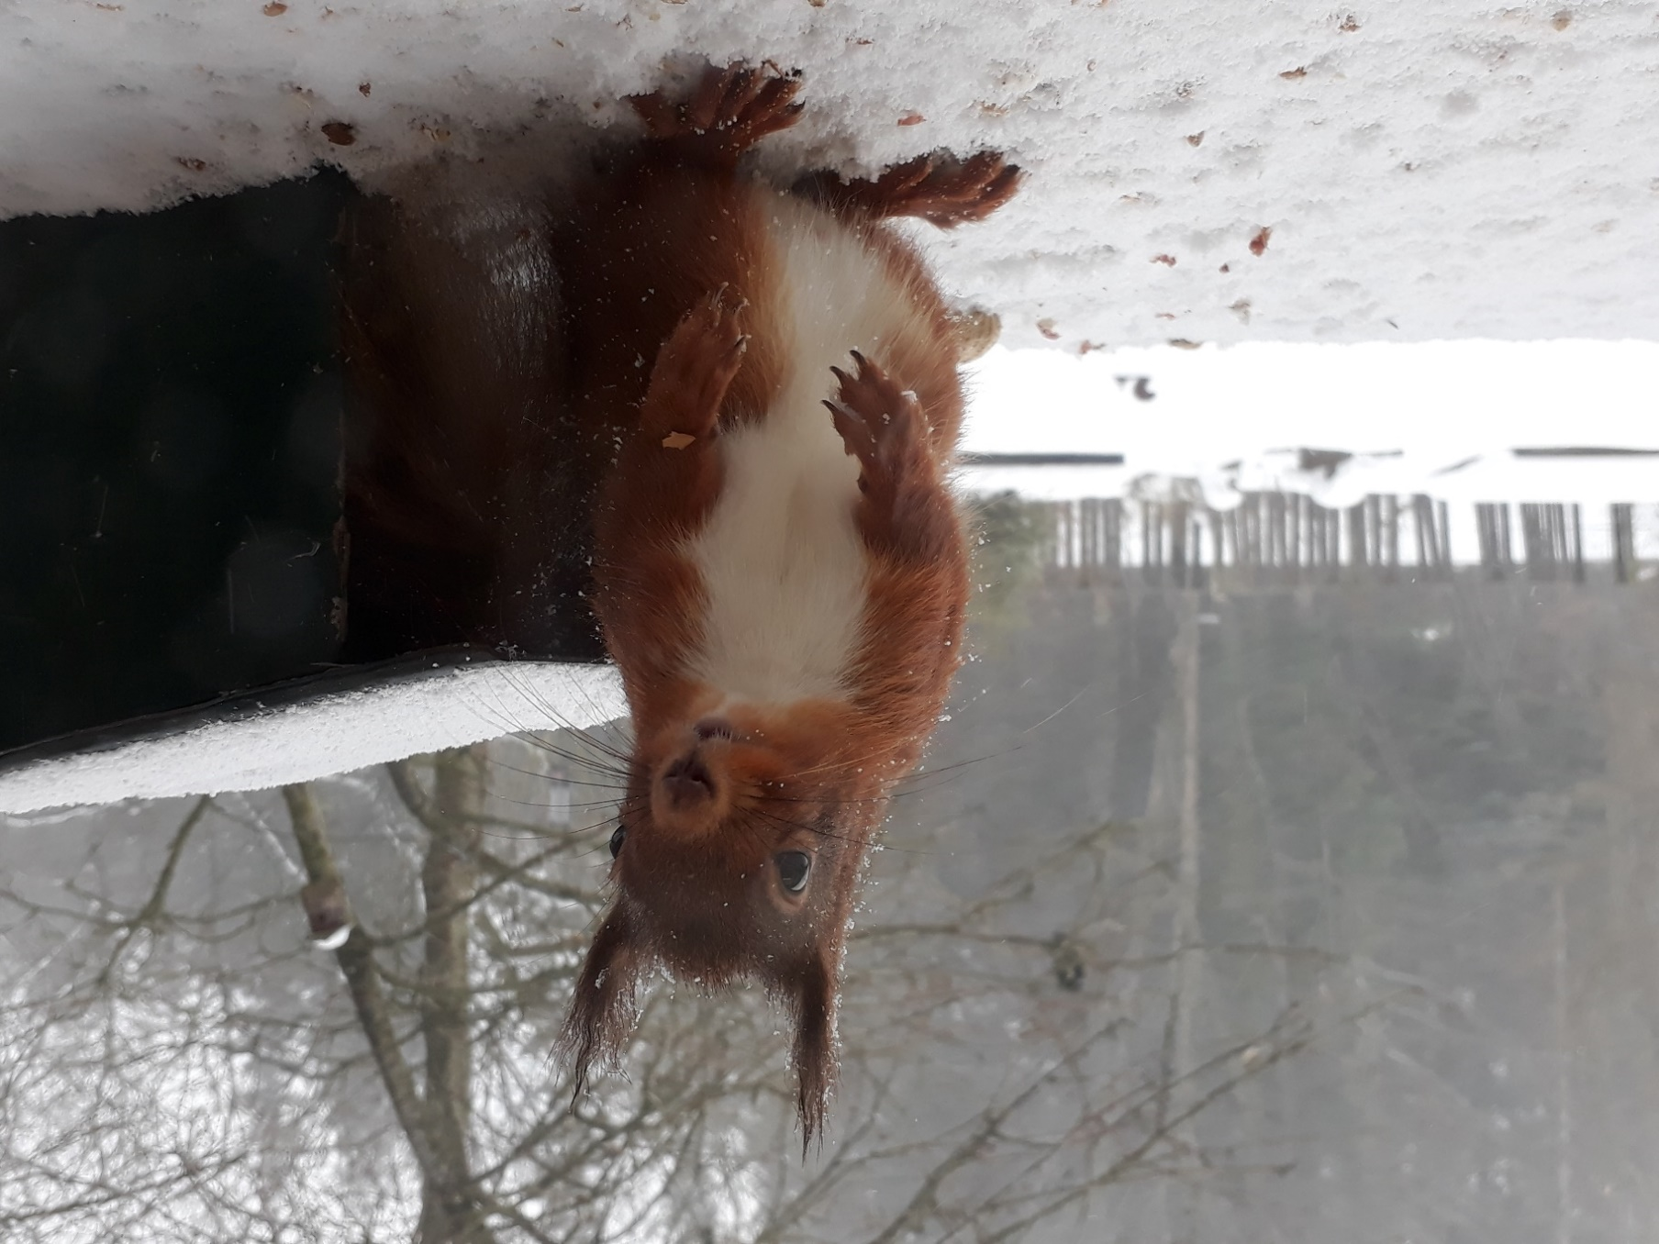
Shooting - an effective, safe practice in Grey squirrel management
to save reds
Stats
Sites
Tool box
WLSI model
Thermal imaging
Q & A’s

Slide 3
Stats - shooting/trapping combination methodology (3 groups/4 years)

Slide 4
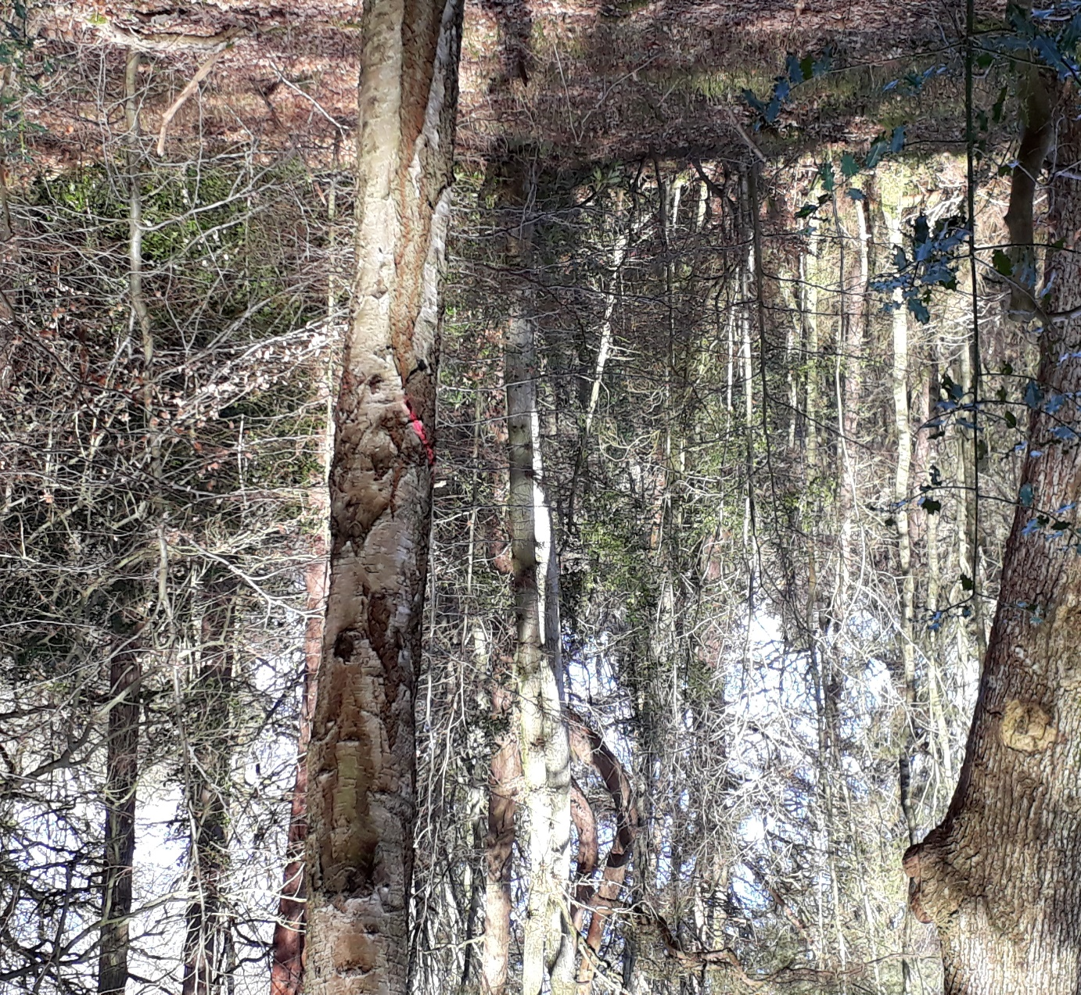
Sites
Where do we shoot?
National Trust
RSPB
Local Councils
United Utilities
LDNPA
Commercial Pheasant Shoots
Private Estates
Private Gardens
Where do we not currently?
Forestry commission
Woodland Trust

Slide 5
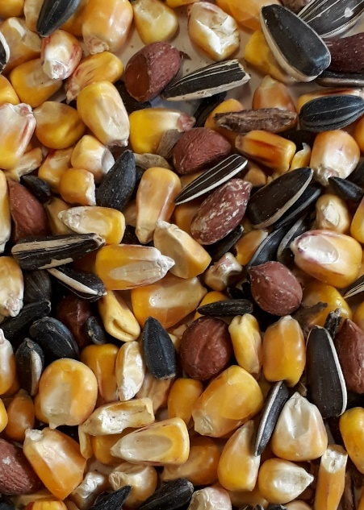
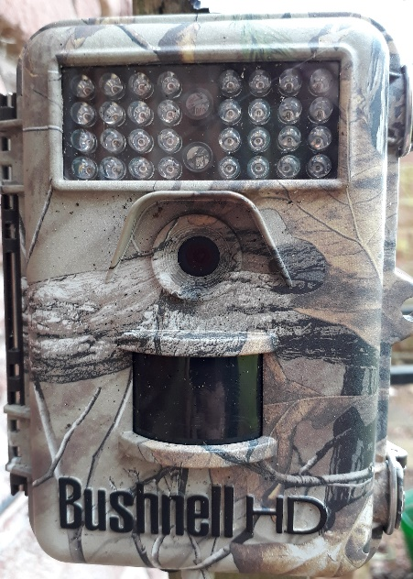
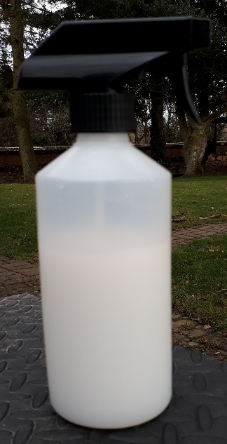
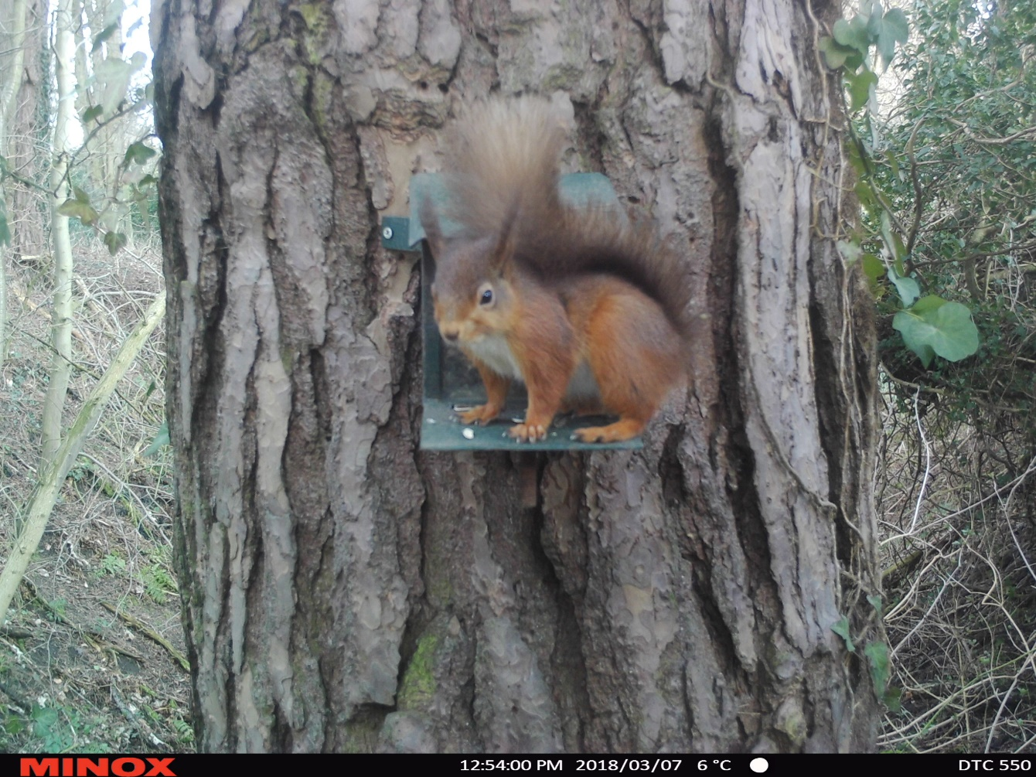
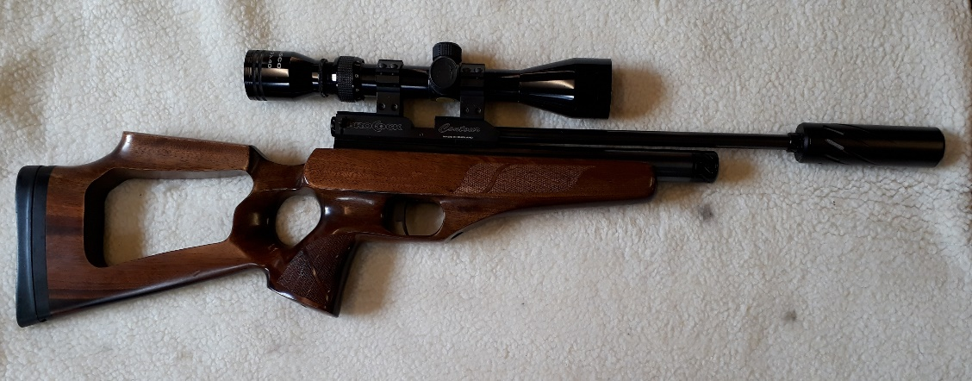
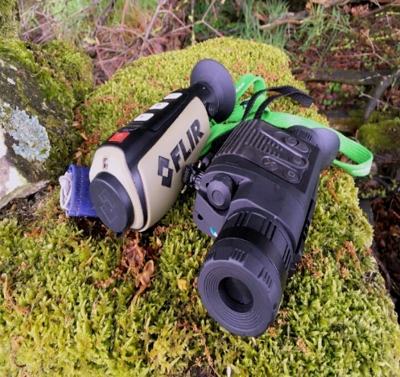
Tool Box
Feeders/monitoring mix/trail cameras/thermal imaging/disinfectant.
Co-ordination & recording.
Collaborative action.

Slide 6
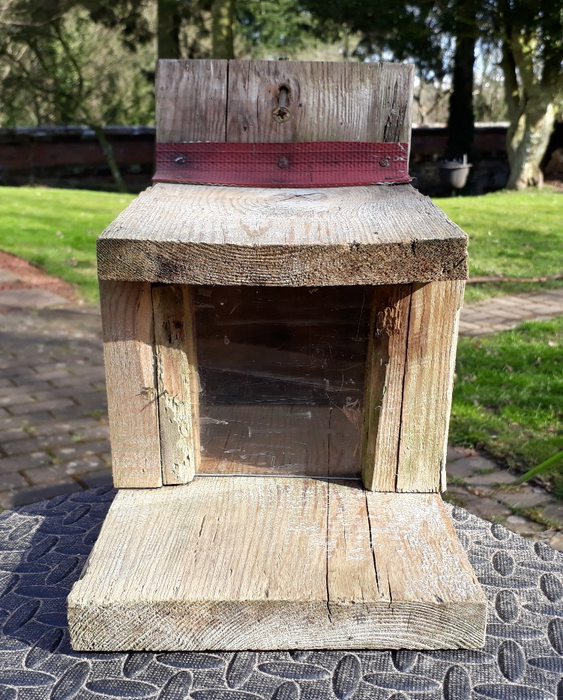
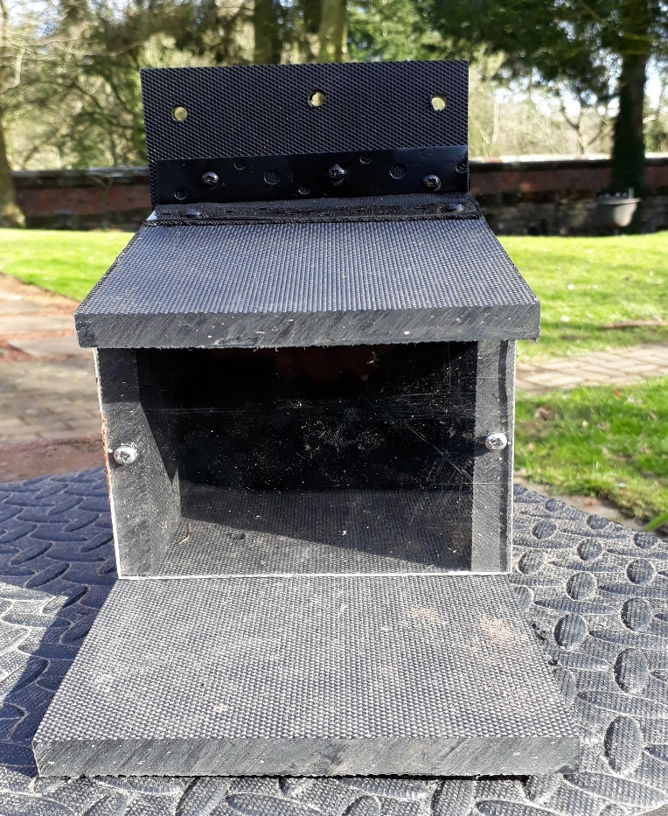
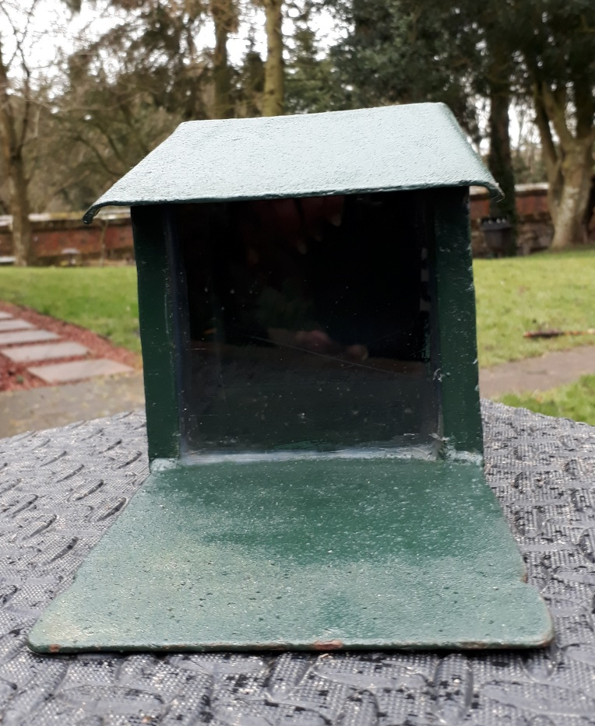
Feeder examples
Wood
Plastic
Metal

Slide 7
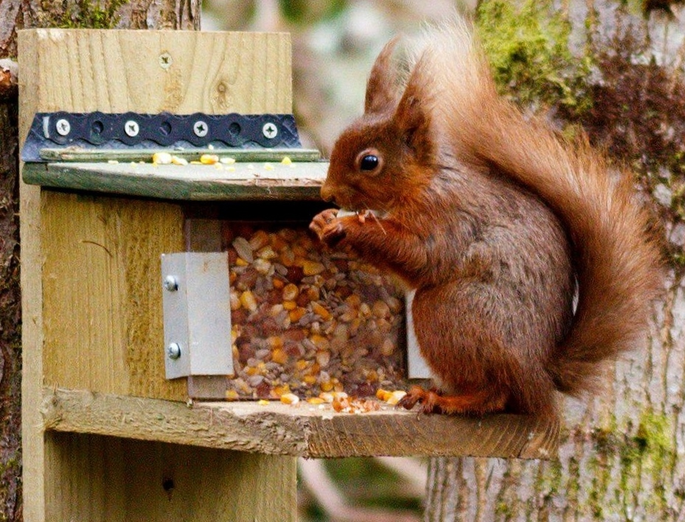
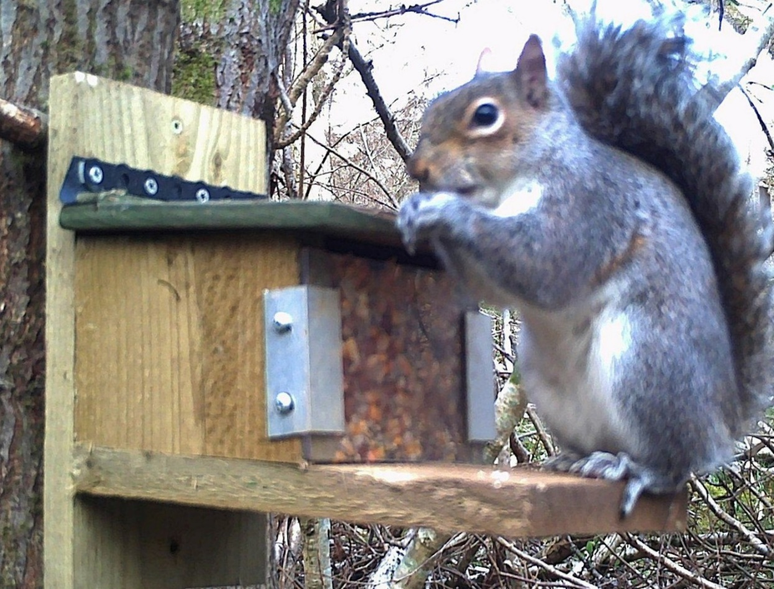
WLSI Squirrel Management Model

Slide 8
Landowner permission given
Insurance in place
Feeder sited with ‘safe’ back-stop
Risk assessment
Skilled operatives

Slide 10
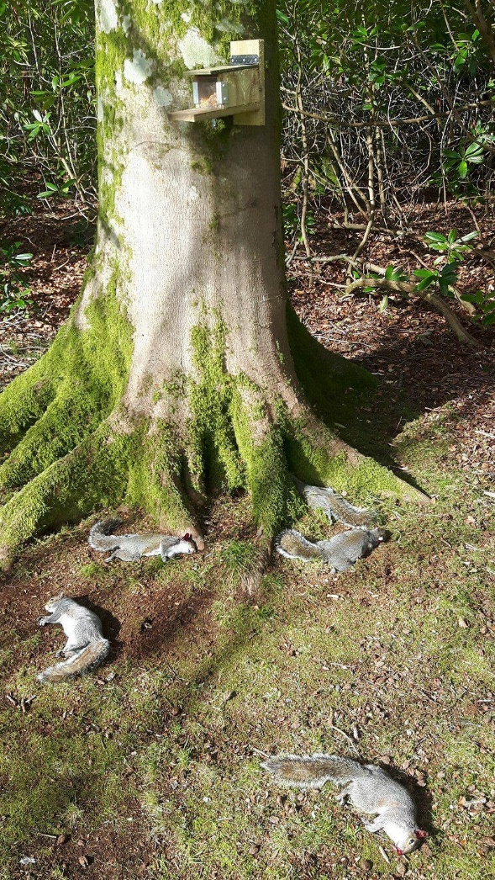
1 Hour of shooting!

Slide 11
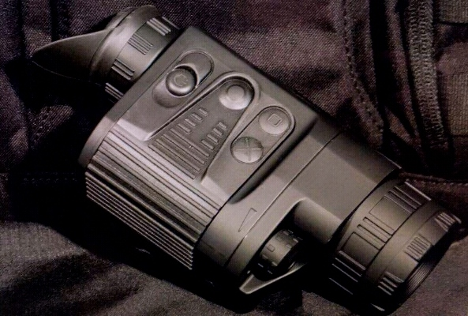
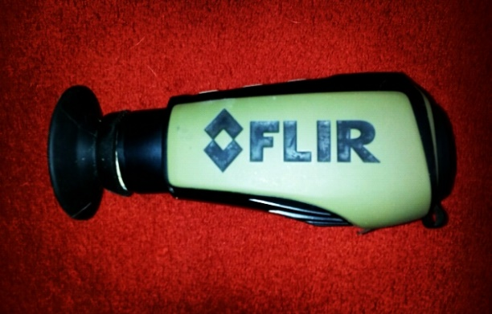
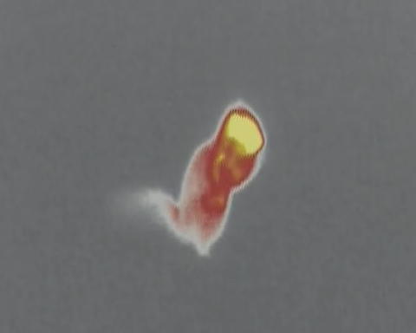
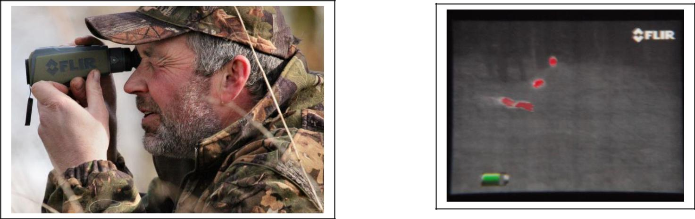
Thermal imaging
Thermal imaging units are a much welcomed addition to equipment lists and increase both the efficiency and effectiveness of squirrel management work.
This technology spots squirrels through the trees, in dense woodland and on the ground, and at significant distances where otherwise the naked eye just wouldn’t see.
A complete game changer helping red squirrel conservation efforts significantly.
Greys shot by 1 operative in 2017 | No. of those that were shot with thermal assistance
493 | 247

Slide 12
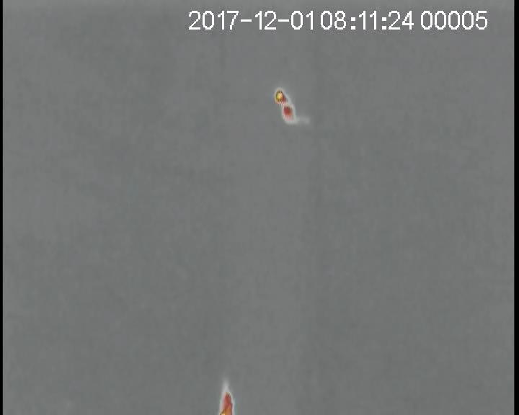

Slide 13
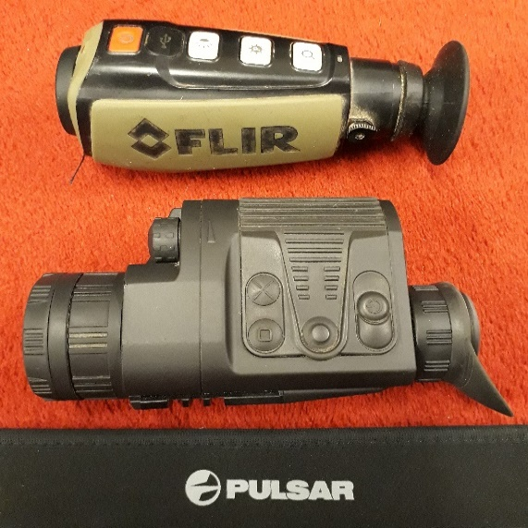
Thermal imaging
Pulsar or Flir – both great
Refresh rate on the Pulsar is 50hz, Flir is 9Hz
DNV double pack with Pulsar - always got a spare
Pulsar works in sun
Turn close for the objective lens
Lens can be focussed as well as the diopter
Left or Right handed
Less expensive
Recommendations for Pulsar use
ID mode (not City or Forest)
Adjust brightness in front wheel
Don’t zoom in
Discounts on units
See me later

Slide 14
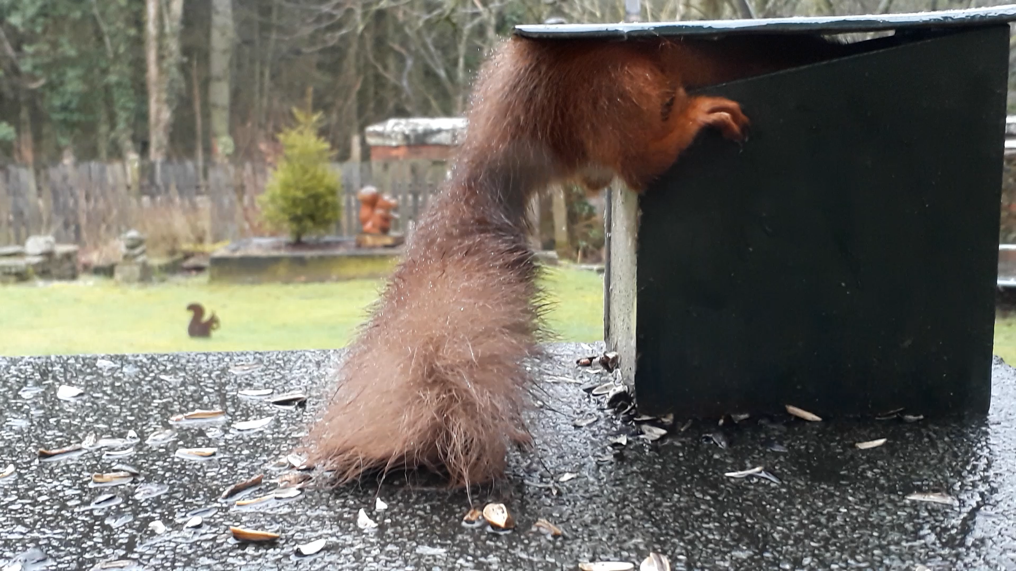

Slide 15
Questions

