Slide 1
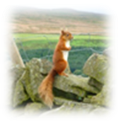
Red Squirrel Conservation Priorities in the UK
Nick Leeming
Chairman – Northern Red Squirrels (Northumberland)
Northern Red Squirrels

Slide 2
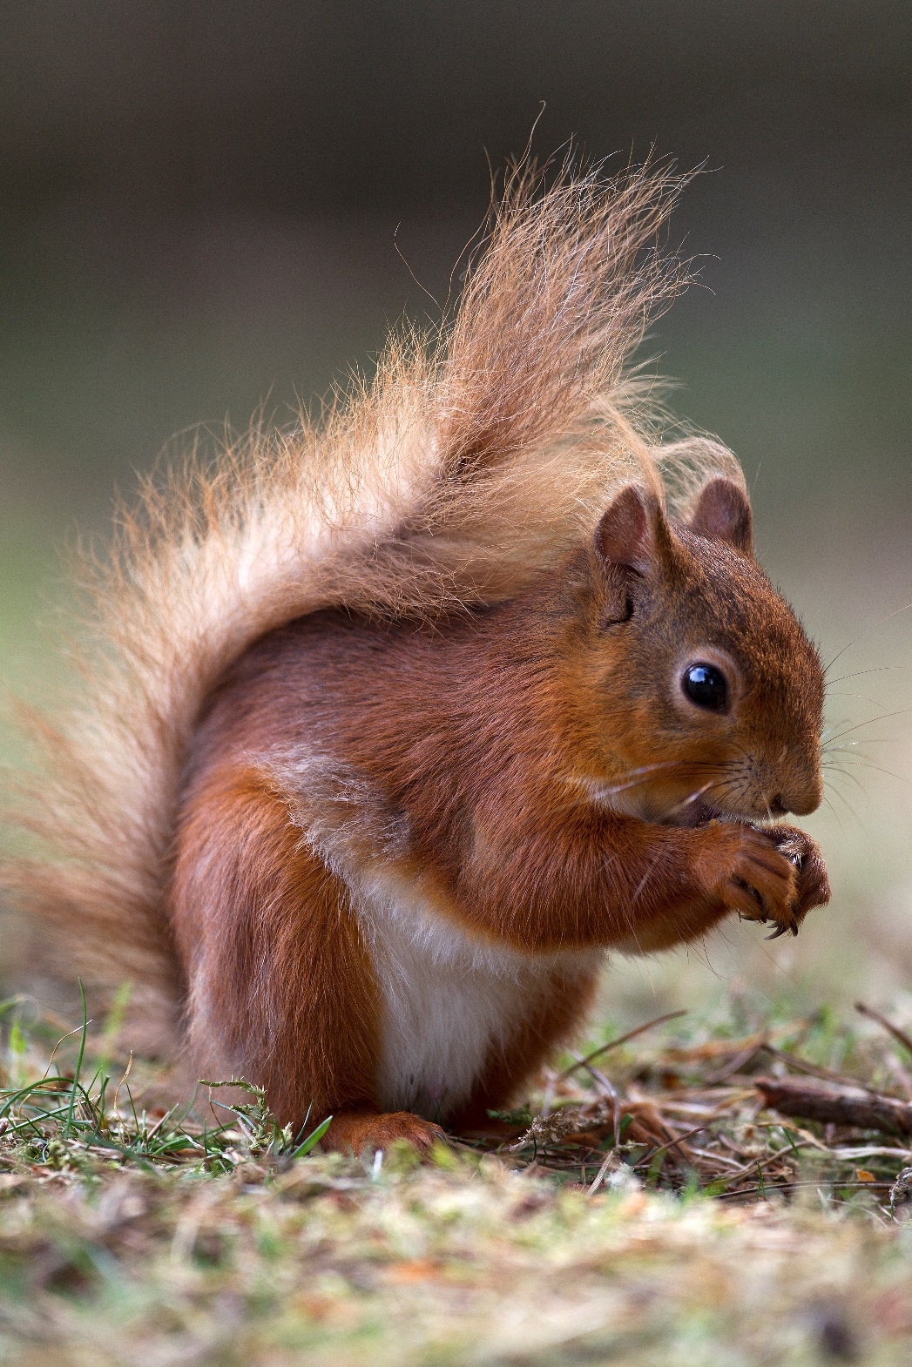
Overall objective
To re-establish the red squirrel in the UK
Practicalities of eradication
Thoughts on national strategy
Northern Red Squirrels

Slide 3
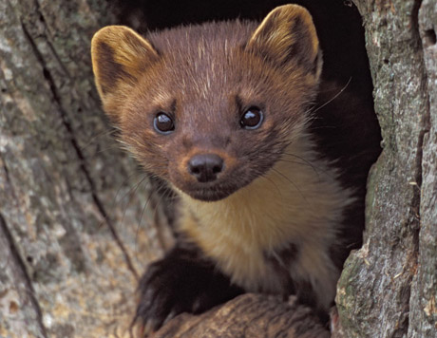
Methods of control
Free shooting on sight (thermal imaging)
Target shooting of greys at feeders
Live trapping
Kill trapping using feed or chemical lure
Fertility control: using standard squirrel feeder
Fertility control: using grey-only squirrel feeder
Pine martens as predators
Northern Red Squirrels

Slide 4
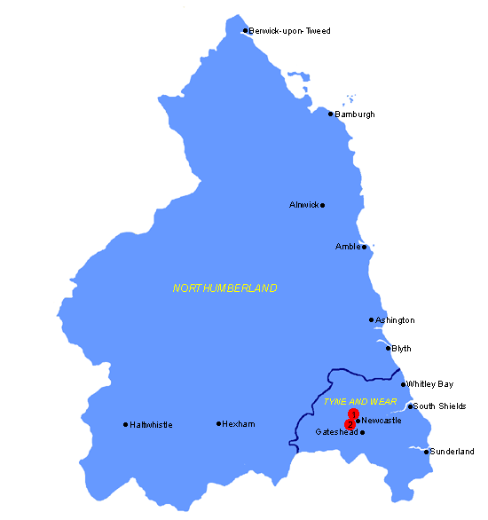
Northumberland
Northern Red Squirrels

Slide 5
Landscape type - cities and large towns
Northern Red Squirrels

Slide 6
Landscape type - rural and sub-rural areas with small towns and villages
Northern Red Squirrels

Slide 7
Landscape type - sparsely populated agricultural areas with little woodland
Northern Red Squirrels

Slide 8
Landscape type - sparsely populated agricultural areas with much woodland
Northern Red Squirrels

Slide 9
Landscape type - large areas of forest
Northern Red Squirrels

Slide 10
Area type | Control method
 | Free shooting | Target shooting | Live trap | Kill trap (grey-only areas) | Fertility control standard feeder | Fertility control grey-only feeder | Pine marten
cities, large towns | No | Limited | Yes, gardens | Yes, gardens | Yes | Yes | No
rural and sub-rural | Yes | Limited | Yes | Yes | Yes | Yes | No
agricultural areas with little woodland | Yes | Yes | Yes | Yes | Yes | Yes | No
agricultural areas with much woodland | Yes | Yes | Yes | Yes | Yes | Yes | ??
unpopulated forest | Limited to fringes | Limited to fringes | Limited to fringes | Limited to fringes | Yes, if pine martens absent | Yes, if pine martens absent | Yes

Slide 11
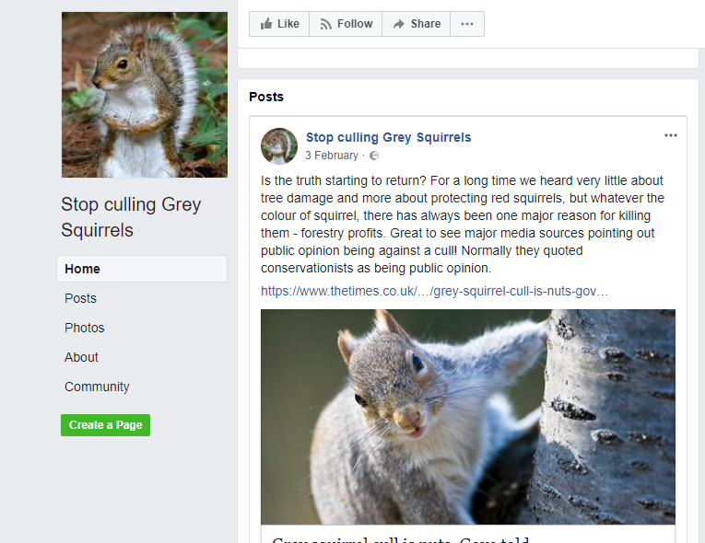
Thoughts on the future…
No more reviews, time wasting
Immunocontraceptive is key
Involve communities – local champion vital
Professional Rangers essential
Anticipate and plan for adverse public reaction
Red squirrel sanctuaries
Northern Red Squirrels

Slide 12
Thoughts on the future…
Maintain and augment existing red areas
Work in from peninsula and coasts in grey areas
Work out from red areas
Reintroduce reds in safe zones
Or promote immunocontraceptive use everywhere all at once?
Post-eradication monitoring and clean-up
Use modelling to estimate which is best
Northern Red Squirrels

Slide 13
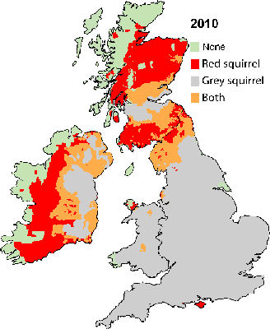
Thoughts on the future…
Best methods for territory
Use large scale field trials
Prior to approval of immunocontraceptive?
Appropriate data
Standard operating procedures
Change in the law?
Continuous monitoring of red and grey distribution
Northern Red Squirrels

Slide 14
Conclusion
Eradication of grey squirrel (at least on regional basis) is key
Immunocontraceptive probably essential for success
Appropriate techniques for different landscapes
Community involvement and professional Rangers essential
Must always be professional, humane and low-key
Intensive follow up to prevent recolonization
Red squirrels at dedicated sanctuaries for future release
Northern Red Squirrels

Slide 15
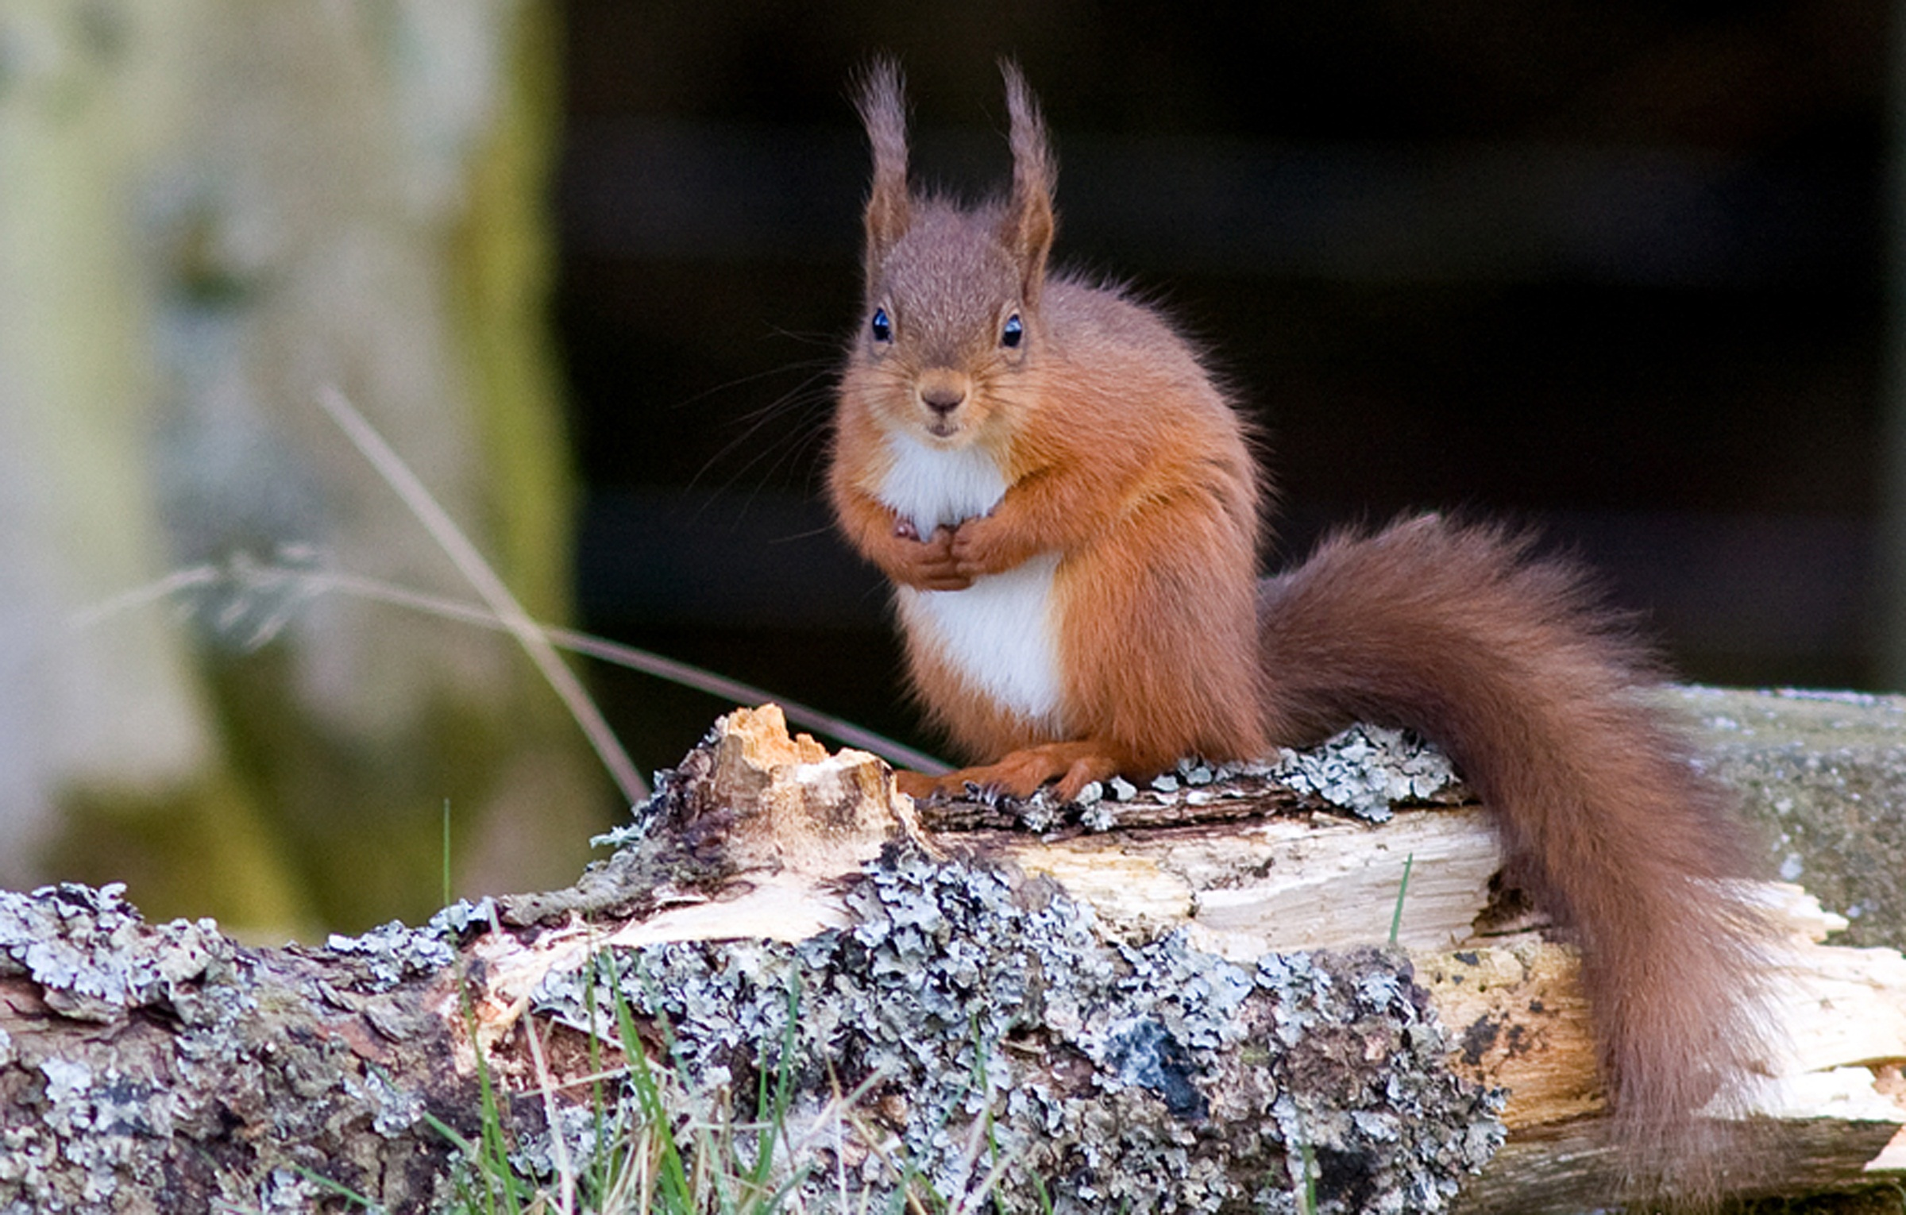
Thank you!
nickleeming65@gmail.com

